Slide 1

Intelligent Optimization in Chemical Engineering
Hua Zhou
cezhouh@xmu.edu.cn
10/30/2024
College of Chemistry & Chemical Engineering

Slide 2
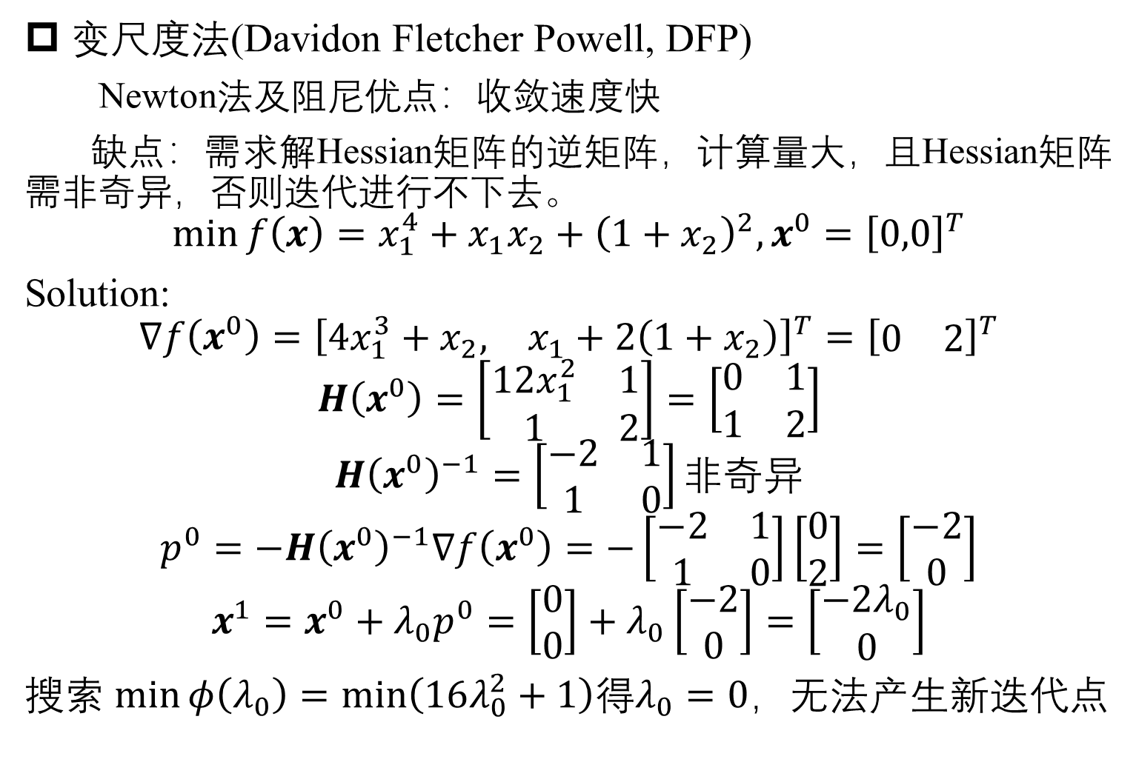
Optimization algorithm for multi-variables
变尺度法(Davidon Fletcher Powell, DFP)
Newton法及阻尼优点：收敛速度快
缺点：需求解Hessian矩阵的逆矩阵，计算量大，且Hessian矩阵需非奇异，否则迭代进行不下去。
$$\min{f\left(x\right)=x_{1}^{4}+x_{1}x_{2}+{\left(1+x_{2}\right)}^{2}, x^{0}={\left[0,0\right]}^{T}}$$
Solution:
$$∇f\left(x^{0}\right)={\left[\begin{matrix}4x_{1}^{3}+x_{2}, & x_{1}+2\left(1+x_{2}\right)\end{matrix}\right]}^{T}={\left[\begin{matrix}0 & 2\end{matrix}\right]}^{T}$$
$$H\left(x^{0}\right)=\left[\begin{matrix}12x_{1}^{2} & 1 \\ 1 & 2\end{matrix}\right]=\left[\begin{matrix}0 & 1 \\ 1 & 2\end{matrix}\right]$$
$$H{\left(x^{0}\right)}^{−1}=\left[\begin{matrix}−2 & 1 \\ 1 & 0\end{matrix}\right]非奇异$$
$$p^{0}=−H{\left(x^{0}\right)}^{−1}∇f\left(x^{0}\right)=−\left[\begin{matrix}−2 & 1 \\ 1 & 0\end{matrix}\right]\left[\begin{matrix}0 \\ 2\end{matrix}\right]=\left[\begin{matrix}−2 \\ 0\end{matrix}\right]$$
$$x^{1}=x^{0}+λ_{0}p^{0}=\left[\begin{matrix}0 \\ 0\end{matrix}\right]+λ_{0}\left[\begin{matrix}−2 \\ 0\end{matrix}\right]=\left[\begin{matrix}−2λ_{0} \\ 0\end{matrix}\right]$$
搜索 $\min{φ\left(λ_{0}\right)=\min\left(16λ_{0}^{2}+1\right)}$得$λ_{0}=0$，无法产生新迭代点

Slide 3
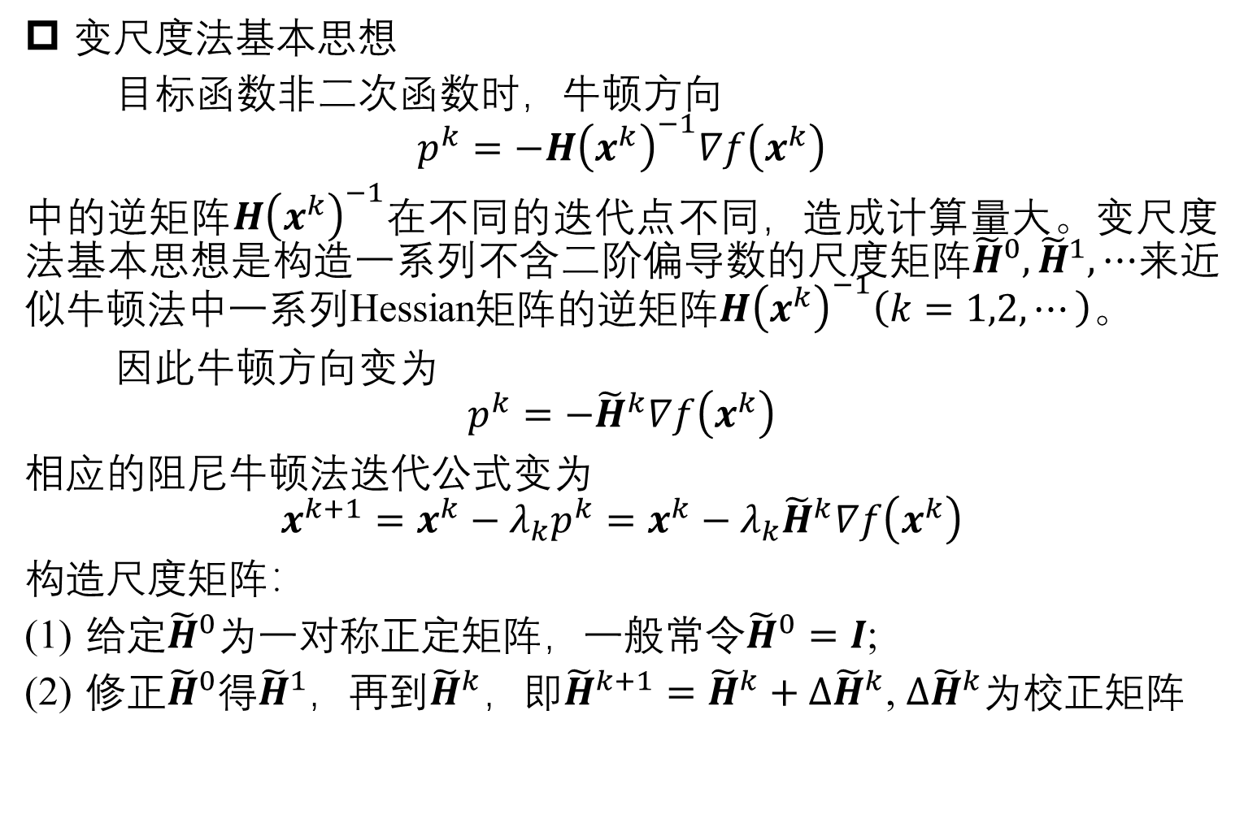
Optimization algorithm for multi-variables
变尺度法基本思想
目标函数非二次函数时，牛顿方向
$$p^{k}=−H{\left(x^{k}\right)}^{−1}∇f\left(x^{k}\right)$$
中的逆矩阵$H{\left(x^{k}\right)}^{−1}$在不同的迭代点不同，造成计算量大。变尺度法基本思想是构造一系列不含二阶偏导数的尺度矩阵${\tilde{H}}^{0},{\tilde{H}}^{1},⋯$来近似牛顿法中一系列Hessian矩阵的逆矩阵$H{\left(x^{k}\right)}^{−1}\left(k=1,2,⋯\right)$。
因此牛顿方向变为
$$p^{k}=−{\tilde{H}}^{k}∇f\left(x^{k}\right)$$
相应的阻尼牛顿法迭代公式变为
$$x^{k+1}=x^{k}−λ_{k}p^{k}=x^{k}−λ_{k}{\tilde{H}}^{k}∇f\left(x^{k}\right)$$
构造尺度矩阵：
给定${\tilde{H}}^{0}$为一对称正定矩阵，一般常令${\tilde{H}}^{0}=I$;
修正${\tilde{H}}^{0}$得${\tilde{H}}^{1}$，再到${\tilde{H}}^{k}$，即${\tilde{H}}^{k+1}={\tilde{H}}^{k}+{Δ\tilde{H}}^{k}$, ${Δ\tilde{H}}^{k}$为校正矩阵

Slide 4
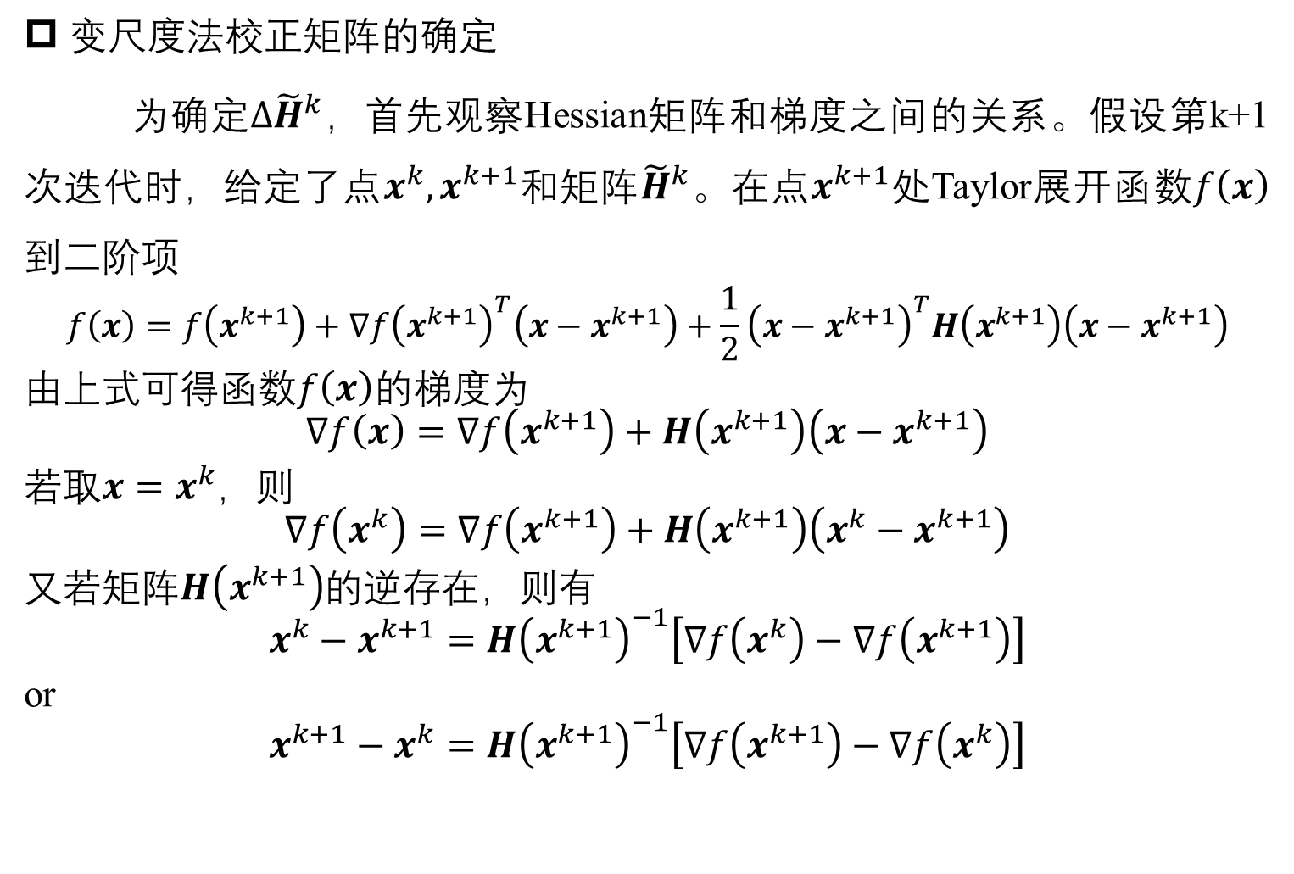
Optimization algorithm for multi-variables
变尺度法校正矩阵的确定
为确定${Δ\tilde{H}}^{k}$，首先观察Hessian矩阵和梯度之间的关系。假设第k+1次迭代时，给定了点$x^{k},x^{k+1}$和矩阵${\tilde{H}}^{k}$。在点$x^{k+1}$处Taylor展开函数$f\left(x\right)$到二阶项
$$f\left(x\right)=f\left(x^{k+1}\right)+∇f{\left(x^{k+1}\right)}^{T}\left(x−x^{k+1}\right)+\frac{1}{2}{\left(x−x^{k+1}\right)}^{T}H\left(x^{k+1}\right)\left(x−x^{k+1}\right)$$
由上式可得函数$f\left(x\right)$的梯度为
$$∇f\left(x\right)=∇f\left(x^{k+1}\right)+H\left(x^{k+1}\right)\left(x−x^{k+1}\right)$$
若取$x=x^{k}$，则
$$∇f\left(x^{k}\right)=∇f\left(x^{k+1}\right)+H\left(x^{k+1}\right)\left(x^{k}−x^{k+1}\right)$$
又若矩阵$H\left(x^{k+1}\right)$的逆存在，则有
$$x^{k}−x^{k+1}=H{\left(x^{k+1}\right)}^{−1}\left[∇f\left(x^{k}\right)−∇f\left(x^{k+1}\right)\right]$$
or
$$x^{k+1}−x^{k}=H{\left(x^{k+1}\right)}^{−1}\left[∇f\left(x^{k+1}\right)−∇f\left(x^{k}\right)\right]$$

Slide 5
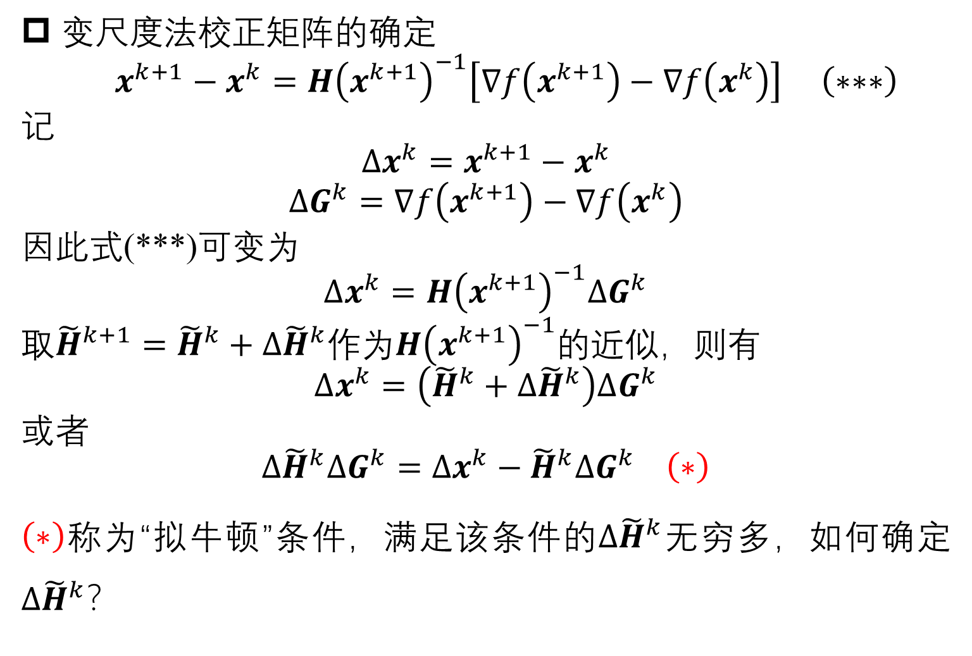
Optimization algorithm for multi-variables
变尺度法校正矩阵的确定
$x^{k+1}−x^{k}=H{\left(x^{k+1}\right)}^{−1}\left[∇f\left(x^{k+1}\right)−∇f\left(x^{k}\right)\right] \left(∗∗∗\right)$
记
$$Δx^{k}=x^{k+1}−x^{k}$$
$$ΔG^{k}=∇f\left(x^{k+1}\right)−∇f\left(x^{k}\right)$$
因此式(***)可变为
$$Δx^{k}=H{\left(x^{k+1}\right)}^{−1}ΔG^{k}$$
取${\tilde{H}}^{k+1}={\tilde{H}}^{k}+{Δ\tilde{H}}^{k}$作为$H{\left(x^{k+1}\right)}^{−1}$的近似，则有
$$Δx^{k}=\left({\tilde{H}}^{k}+{Δ\tilde{H}}^{k}\right)ΔG^{k}$$
或者
$${Δ\tilde{H}}^{k}ΔG^{k}=Δx^{k}−{\tilde{H}}^{k}ΔG^{k} \left(∗\right)$$
$\left(∗\right)$称为“拟牛顿”条件，满足该条件的${Δ\tilde{H}}^{k}$无穷多，如何确定${Δ\tilde{H}}^{k}$？

Slide 6
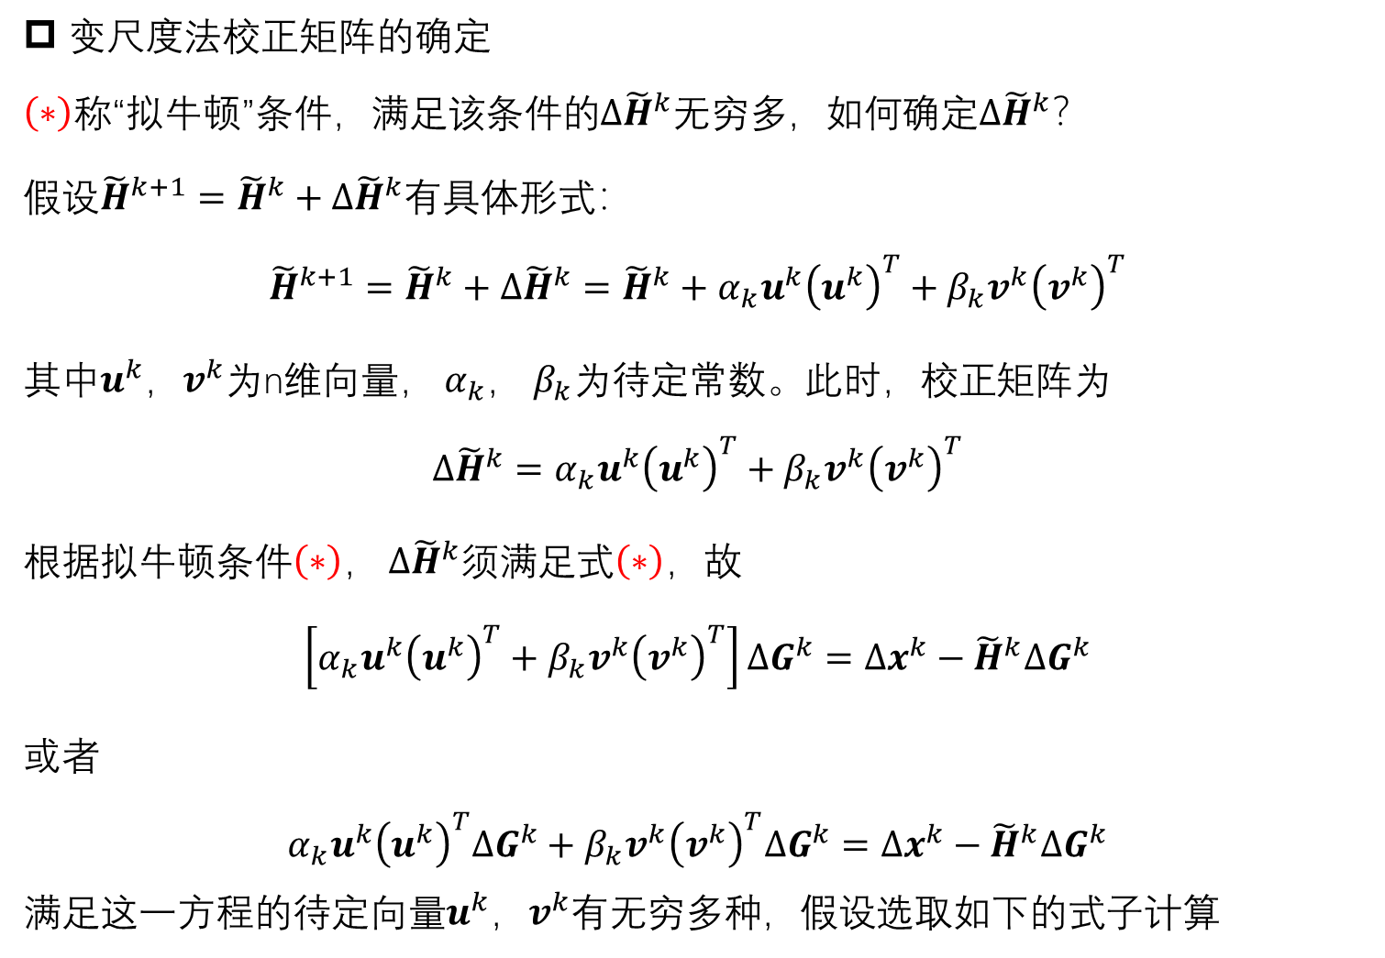
Optimization algorithm for multi-variables
变尺度法校正矩阵的确定
$\left(∗\right)$称“拟牛顿”条件，满足该条件的${Δ\tilde{H}}^{k}$无穷多，如何确定${Δ\tilde{H}}^{k}$？
假设${\tilde{H}}^{k+1}={\tilde{H}}^{k}+{Δ\tilde{H}}^{k}$有具体形式：
$${\tilde{H}}^{k+1}={\tilde{H}}^{k}+{Δ\tilde{H}}^{k}={\tilde{H}}^{k}+α_{k}u^{k}{\left(u^{k}\right)}^{T}+β_{k}v^{k}{\left(v^{k}\right)}^{T}$$
其中$u^{k}$，$v^{k}$为n维向量， $α_{k}$， $β_{k}$为待定常数。此时，校正矩阵为
$${Δ\tilde{H}}^{k}=α_{k}u^{k}{\left(u^{k}\right)}^{T}+β_{k}v^{k}{\left(v^{k}\right)}^{T}$$
根据拟牛顿条件$\left(∗\right)$， ${Δ\tilde{H}}^{k}$须满足式$\left(∗\right)$，故
$$\left[α_{k}u^{k}{\left(u^{k}\right)}^{T}+β_{k}v^{k}{\left(v^{k}\right)}^{T}\right]ΔG^{k}=Δx^{k}−{\tilde{H}}^{k}ΔG^{k}$$
或者
$$α_{k}u^{k}{\left(u^{k}\right)}^{T}ΔG^{k}+β_{k}v^{k}{\left(v^{k}\right)}^{T}ΔG^{k}=Δx^{k}−{\tilde{H}}^{k}ΔG^{k}$$
满足这一方程的待定向量$u^{k}$，$v^{k}$有无穷多种，假设选取如下的式子计算

Slide 7
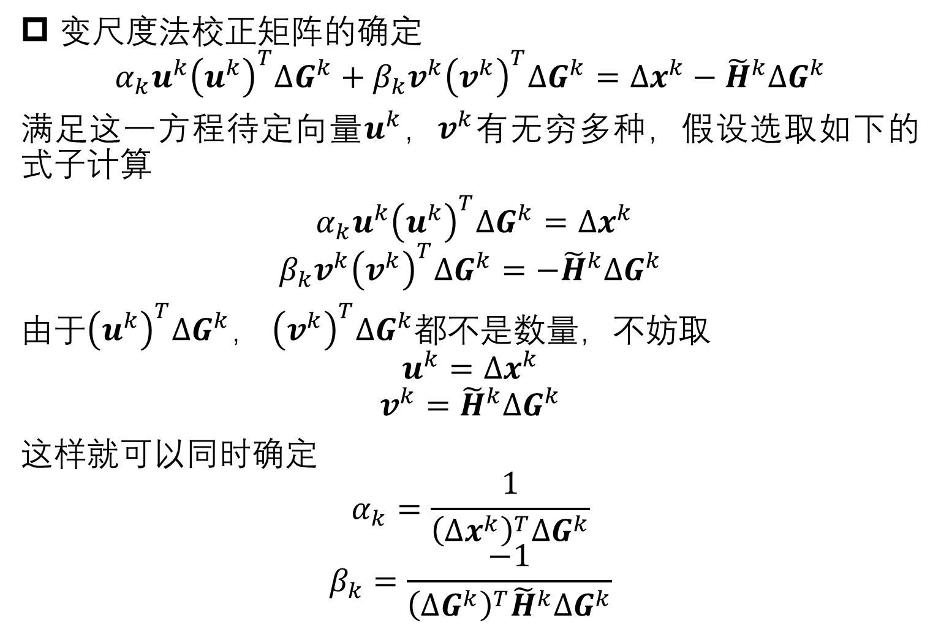
Optimization algorithm for multi-variables
变尺度法校正矩阵的确定
$$α_{k}u^{k}{\left(u^{k}\right)}^{T}ΔG^{k}+β_{k}v^{k}{\left(v^{k}\right)}^{T}ΔG^{k}=Δx^{k}−{\tilde{H}}^{k}ΔG^{k}$$
满足这一方程待定向量$u^{k}$，$v^{k}$有无穷多种，假设选取如下的式子计算
$α_{k}u^{k}{\left(u^{k}\right)}^{T}ΔG^{k}=Δx^{k}$
$$β_{k}v^{k}{\left(v^{k}\right)}^{T}ΔG^{k}=−{\tilde{H}}^{k}ΔG^{k}$$
由于${\left(u^{k}\right)}^{T}ΔG^{k}$， ${\left(v^{k}\right)}^{T}ΔG^{k}$都不是数量，不妨取
$$u^{k}=Δx^{k}$$
$$v^{k}={\tilde{H}}^{k}ΔG^{k}$$
这样就可以同时确定
$$α_{k}=\frac{1}{{\left(Δx^{k}\right)}^{T}ΔG^{k}}$$
$$β_{k}=\frac{−1}{{\left(ΔG^{k}\right)}^{T}{\tilde{H}}^{k}ΔG^{k}}$$

Slide 8
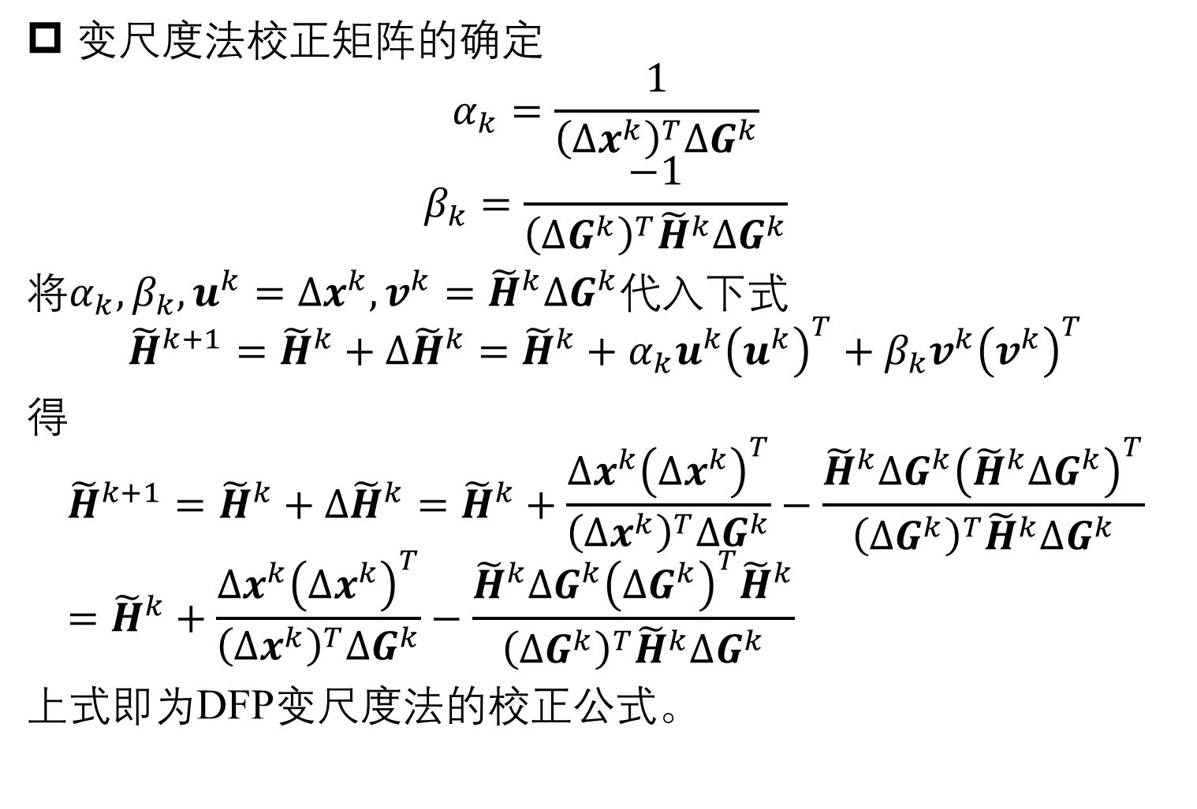
Optimization algorithm for multi-variables
变尺度法校正矩阵的确定
$$α_{k}=\frac{1}{{\left(Δx^{k}\right)}^{T}ΔG^{k}}$$
$$β_{k}=\frac{−1}{{\left(ΔG^{k}\right)}^{T}{\tilde{H}}^{k}ΔG^{k}}$$
将$α_{k},β_{k},u^{k}=Δx^{k},v^{k}={\tilde{H}}^{k}ΔG^{k}$代入下式
$${\tilde{H}}^{k+1}={\tilde{H}}^{k}+{Δ\tilde{H}}^{k}={\tilde{H}}^{k}+α_{k}u^{k}{\left(u^{k}\right)}^{T}+β_{k}v^{k}{\left(v^{k}\right)}^{T}$$
得
$${\tilde{H}}^{k+1}={\tilde{H}}^{k}+{Δ\tilde{H}}^{k}={\tilde{H}}^{k}+\frac{Δx^{k}{\left(Δx^{k}\right)}^{T}}{{\left(Δx^{k}\right)}^{T}ΔG^{k}}−\frac{{\tilde{H}}^{k}ΔG^{k}{\left({\tilde{H}}^{k}ΔG^{k}\right)}^{T}}{{\left(ΔG^{k}\right)}^{T}{\tilde{H}}^{k}ΔG^{k}}={\tilde{H}}^{k}+\frac{Δx^{k}{\left(Δx^{k}\right)}^{T}}{{\left(Δx^{k}\right)}^{T}ΔG^{k}}−\frac{{\tilde{H}}^{k}ΔG^{k}{\left(ΔG^{k}\right)}^{T}{\tilde{H}}^{k}}{{\left(ΔG^{k}\right)}^{T}{\tilde{H}}^{k}ΔG^{k}}$$
上式即为DFP变尺度法的校正公式。

Slide 9
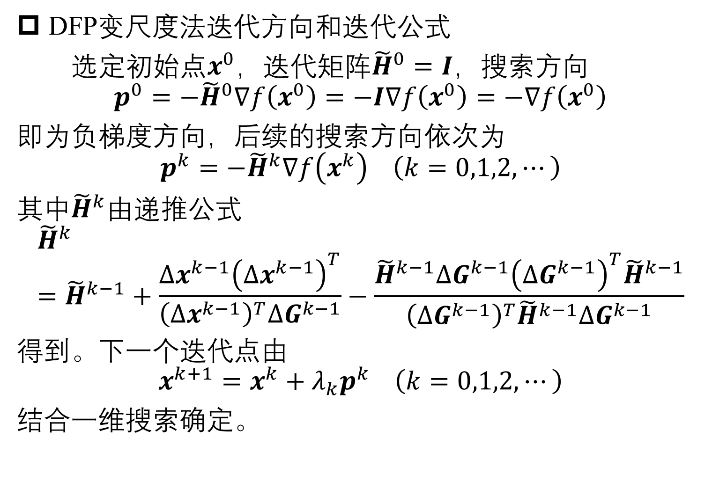
Optimization algorithm for multi-variables
DFP变尺度法迭代方向和迭代公式
选定初始点$x^{0}$，迭代矩阵${\tilde{H}}^{0}=I$，搜索方向
$$p^{0}=−{\tilde{H}}^{0}∇f\left(x^{0}\right)=−I∇f\left(x^{0}\right)=−∇f\left(x^{0}\right)$$
即为负梯度方向，后续的搜索方向依次为
$$p^{k}=−{\tilde{H}}^{k}∇f\left(x^{k}\right) \left(k=0,1,2,⋯\right)$$
其中${\tilde{H}}^{k}$由递推公式
$${\tilde{H}}^{k}={\tilde{H}}^{k−1}+\frac{Δx^{k−1}{\left(Δx^{k−1}\right)}^{T}}{{\left(Δx^{k−1}\right)}^{T}ΔG^{k−1}}−\frac{{\tilde{H}}^{k−1}ΔG^{k−1}{\left(ΔG^{k−1}\right)}^{T}{\tilde{H}}^{k−1}}{{\left(ΔG^{k−1}\right)}^{T}{\tilde{H}}^{k−1}ΔG^{k−1}}$$
得到。下一个迭代点由
$$x^{k+1}=x^{k}+λ_{k}p^{k} \left(k=0,1,2,⋯\right)$$
结合一维搜索确定。

Slide 10
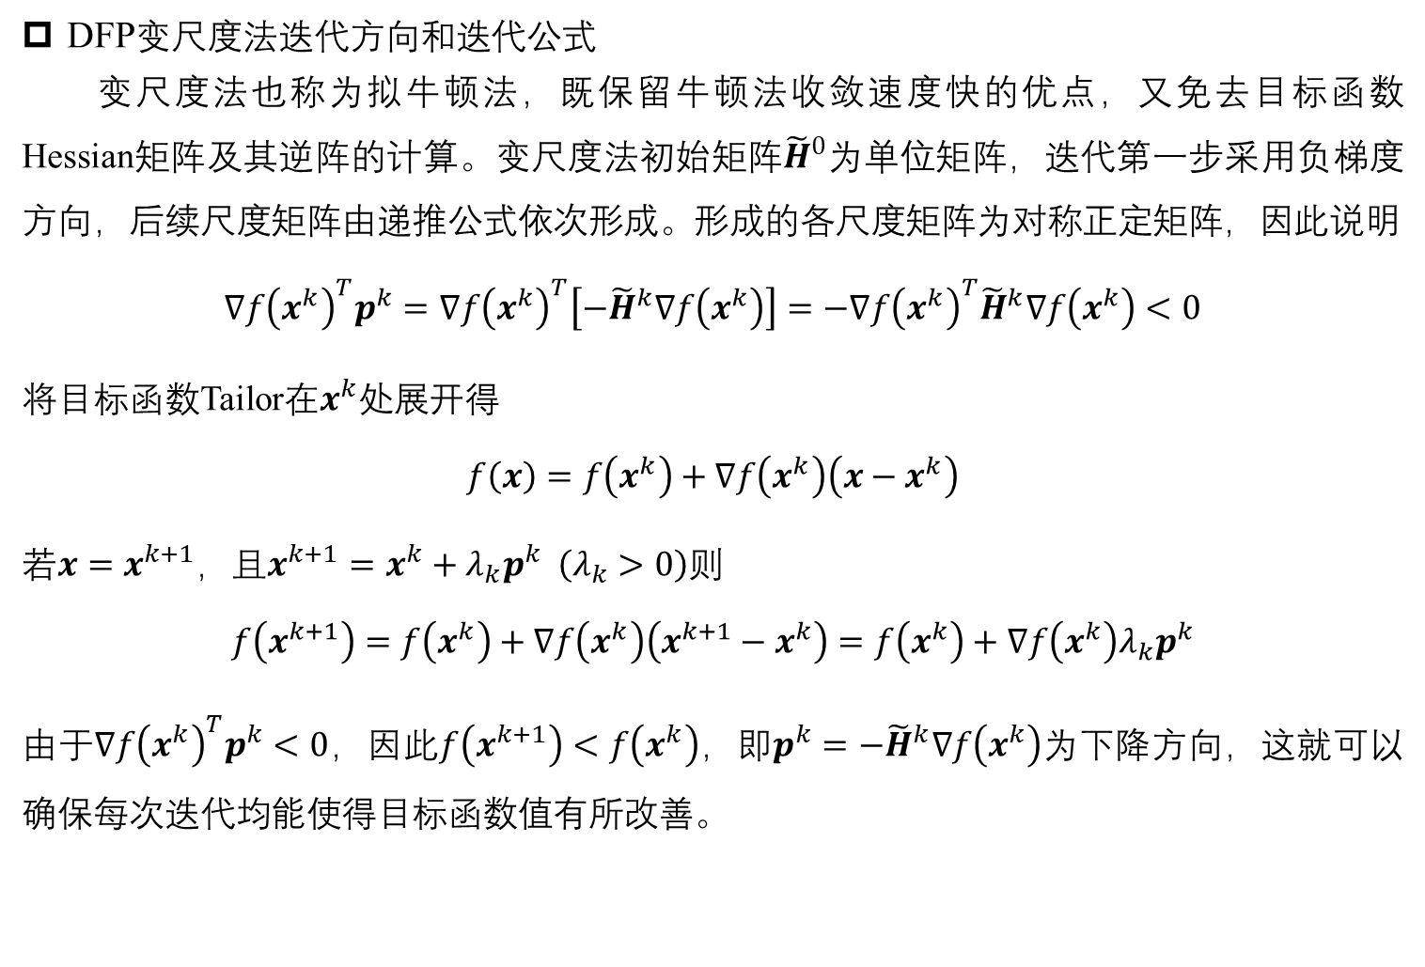
Optimization algorithm for multi-variables
DFP变尺度法迭代方向和迭代公式
变尺度法也称为拟牛顿法，既保留牛顿法收敛速度快的优点，又免去目标函数Hessian矩阵及其逆阵的计算。变尺度法初始矩阵${\tilde{H}}^{0}$为单位矩阵，迭代第一步采用负梯度方向，后续尺度矩阵由递推公式依次形成。形成的各尺度矩阵为对称正定矩阵，因此说明
$$∇f{\left(x^{k}\right)}^{T}p^{k}=∇f{\left(x^{k}\right)}^{T}\left[−{\tilde{H}}^{k}∇f\left(x^{k}\right)\right]=−∇f{\left(x^{k}\right)}^{T}{\tilde{H}}^{k}∇f\left(x^{k}\right)<0$$
将目标函数Tailor在$x^{k}$处展开得
$$f\left(x\right)=f\left(x^{k}\right)+∇f\left(x^{k}\right)\left(x−x^{k}\right)$$
若$x=x^{k+1}$，且$x^{k+1}=x^{k}+λ_{k}p^{k} \left(λ_{k}>0\right)$则
$$f\left(x^{k+1}\right)=f\left(x^{k}\right)+∇f\left(x^{k}\right)\left(x^{k+1}−x^{k}\right)=f\left(x^{k}\right)+∇f\left(x^{k}\right)λ_{k}p^{k}$$
由于$∇f{\left(x^{k}\right)}^{T}p^{k}<0$，因此$f\left(x^{k+1}\right)<f\left(x^{k}\right)$，即$p^{k}=−{\tilde{H}}^{k}∇f\left(x^{k}\right)$为下降方向，这就可以确保每次迭代均能使得目标函数值有所改善。

Slide 11
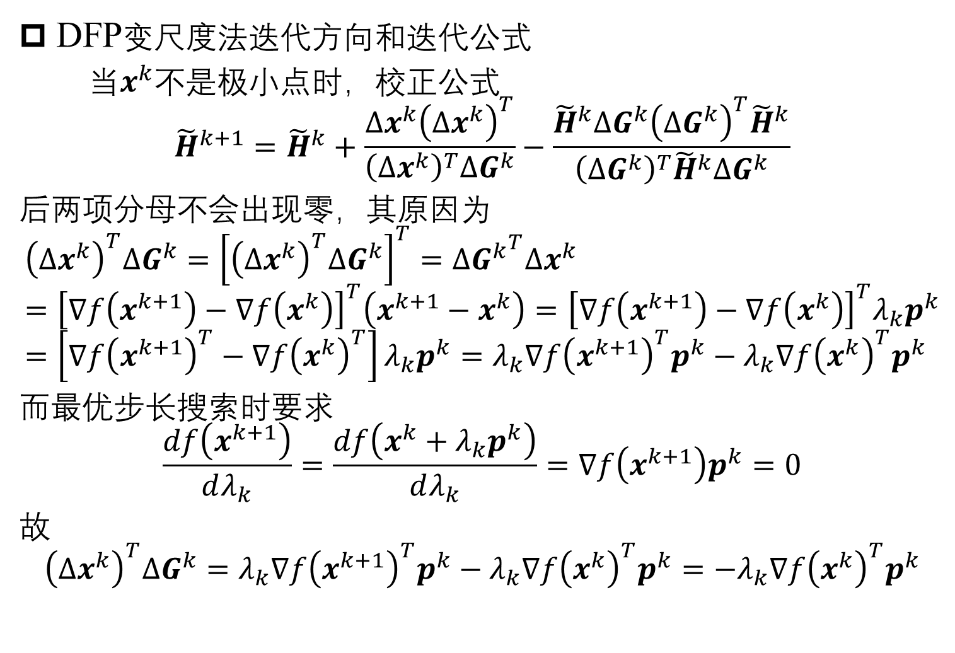
Optimization algorithm for multi-variables
DFP变尺度法迭代方向和迭代公式
当$x^{k}$不是极小点时，校正公式
$${\tilde{H}}^{k+1}={\tilde{H}}^{k}+\frac{Δx^{k}{\left(Δx^{k}\right)}^{T}}{{\left(Δx^{k}\right)}^{T}ΔG^{k}}−\frac{{\tilde{H}}^{k}ΔG^{k}{\left(ΔG^{k}\right)}^{T}{\tilde{H}}^{k}}{{\left(ΔG^{k}\right)}^{T}{\tilde{H}}^{k}ΔG^{k}}$$
后两项分母不会出现零，其原因为
$${\left(Δx^{k}\right)}^{T}ΔG^{k}={\left[{\left(Δx^{k}\right)}^{T}ΔG^{k}\right]}^{T}=Δ{G^{k}}^{T}Δx^{k}={\left[∇f\left(x^{k+1}\right)−∇f\left(x^{k}\right)\right]}^{T}\left(x^{k+1}−x^{k}\right)={\left[∇f\left(x^{k+1}\right)−∇f\left(x^{k}\right)\right]}^{T}λ_{k}p^{k}=\left[∇f{\left(x^{k+1}\right)}^{T}−∇f{\left(x^{k}\right)}^{T}\right]λ_{k}p^{k}=λ_{k}∇f{\left(x^{k+1}\right)}^{T}p^{k}−λ_{k}∇f{\left(x^{k}\right)}^{T}p^{k}$$
而最优步长搜索时要求
$$\frac{df\left(x^{k+1}\right)}{dλ_{k}}=\frac{df\left(x^{k}+λ_{k}p^{k}\right)}{dλ_{k}}=∇f\left(x^{k+1}\right)p^{k}=0$$
故
$${\left(Δx^{k}\right)}^{T}ΔG^{k}=λ_{k}∇f{\left(x^{k+1}\right)}^{T}p^{k}−λ_{k}∇f{\left(x^{k}\right)}^{T}p^{k}=−λ_{k}∇f{\left(x^{k}\right)}^{T}p^{k}$$

Slide 12
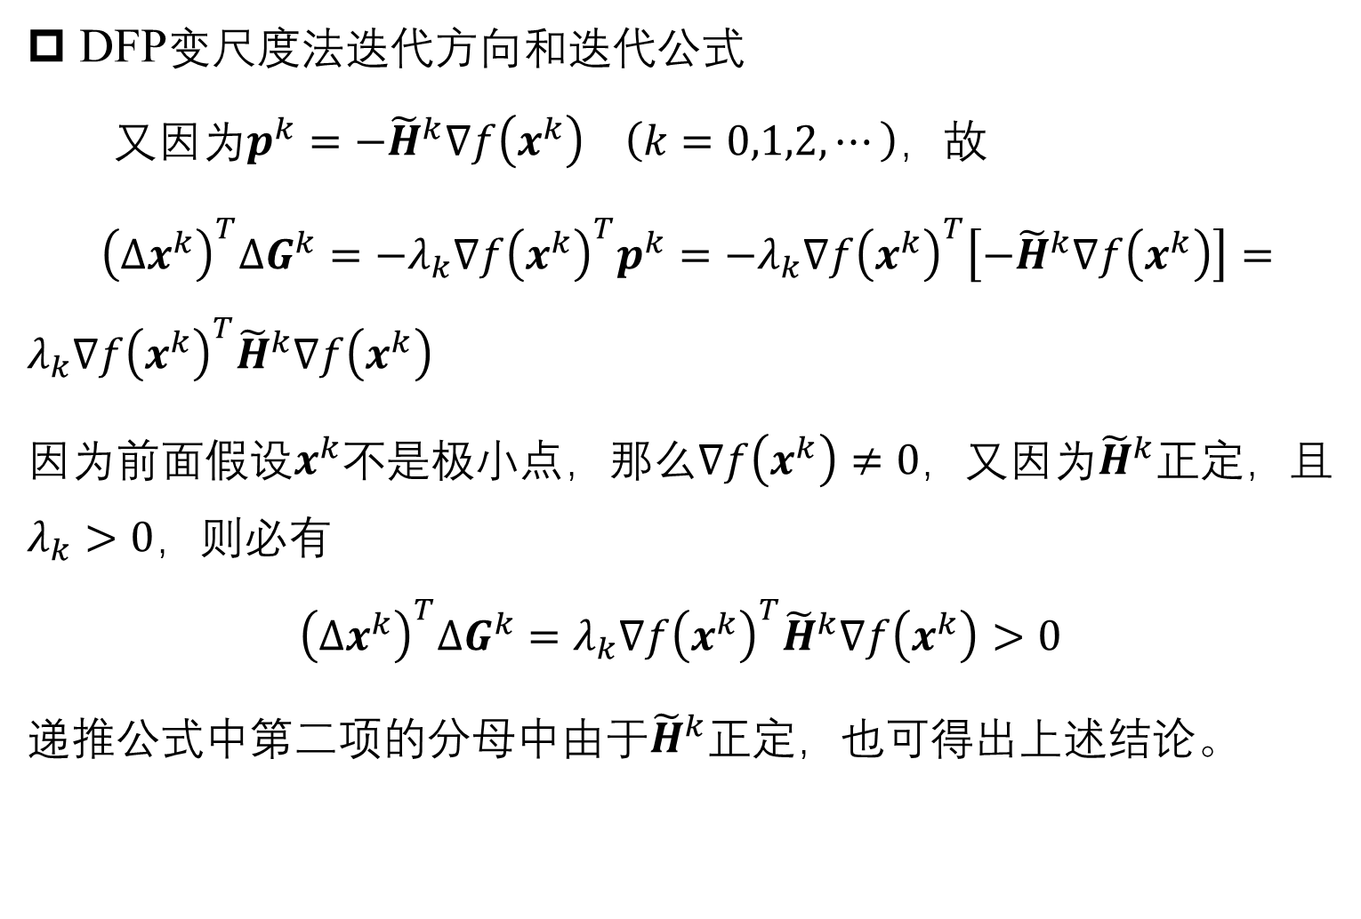
Optimization algorithm for multi-variables
DFP变尺度法迭代方向和迭代公式
又因为$p^{k}=−{\tilde{H}}^{k}∇f\left(x^{k}\right) \left(k=0,1,2,⋯\right)$，故
${\left(Δx^{k}\right)}^{T}ΔG^{k}=−λ_{k}∇f{\left(x^{k}\right)}^{T}p^{k}=−λ_{k}∇f{\left(x^{k}\right)}^{T}\left[−{\tilde{H}}^{k}∇f\left(x^{k}\right)\right]=λ_{k}∇f{\left(x^{k}\right)}^{T}{\tilde{H}}^{k}∇f\left(x^{k}\right)$
因为前面假设$x^{k}$不是极小点，那么$∇f\left(x^{k}\right)≠0$，又因为${\tilde{H}}^{k}$正定，且$λ_{k}>0$，则必有
$${\left(Δx^{k}\right)}^{T}ΔG^{k}=λ_{k}∇f{\left(x^{k}\right)}^{T}{\tilde{H}}^{k}∇f\left(x^{k}\right)>0$$
递推公式中第二项的分母中由于${\tilde{H}}^{k}$正定，也可得出上述结论。

Slide 13
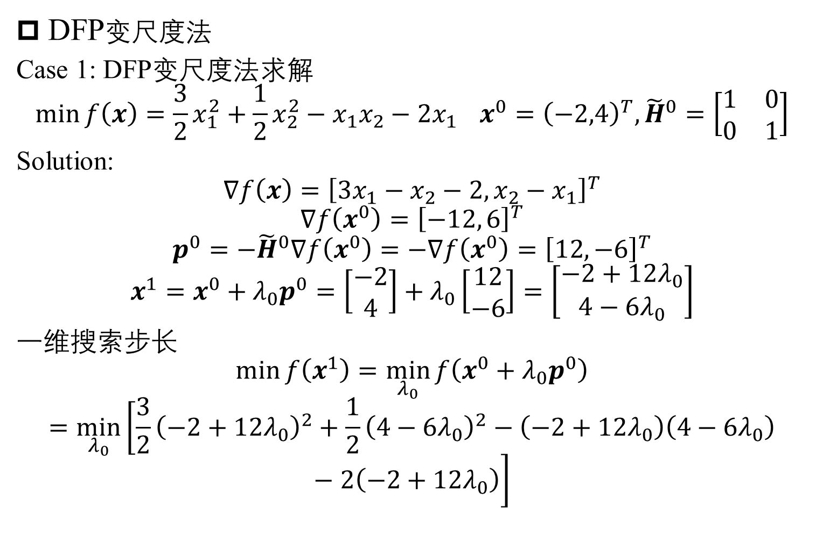
Optimization algorithm for multi-variables
DFP变尺度法
Case 1: DFP变尺度法求解
$$\min{f\left(x\right)=\frac{3}{2}x_{1}^{2}+\frac{1}{2}x_{2}^{2}−x_{1}x_{2}−2x_{1}} x^{0}={\left(−2,4\right)}^{T}, {\tilde{H}}^{0}=\left[\begin{matrix}1 & 0 \\ 0 & 1\end{matrix}\right]$$
Solution:
$$∇f\left(x\right)={\left[3x_{1}−x_{2}−2, x_{2}−x_{1}\right]}^{T}$$
$$∇f\left(x^{0}\right)={\left[−12, 6\right]}^{T}$$
$$p^{0}=−{\tilde{H}}^{0}∇f\left(x^{0}\right)=−∇f\left(x^{0}\right)={\left[12, −6\right]}^{T}$$
$$x^{1}=x^{0}+λ_{0}p^{0}=\left[\begin{matrix}−2 \\ 4\end{matrix}\right]+λ_{0}\left[\begin{matrix}12 \\ −6\end{matrix}\right]=\left[\begin{matrix}−2+12λ_{0} \\ 4−6λ_{0}\end{matrix}\right]$$
一维搜索步长
$$\min{f\left(x^{1}\right)}=\min_{λ_{0}}{f\left(x^{0}+λ_{0}p^{0}\right)}=\min_{λ_{0}}\left[\frac{3}{2}{\left(−2+12λ_{0}\right)}^{2}+\frac{1}{2}{\left(4−6λ_{0}\right)}^{2}−\left(−2+12λ_{0}\right)\left(4−6λ_{0}\right)−2\left(−2+12λ_{0}\right)\right]$$

Slide 14
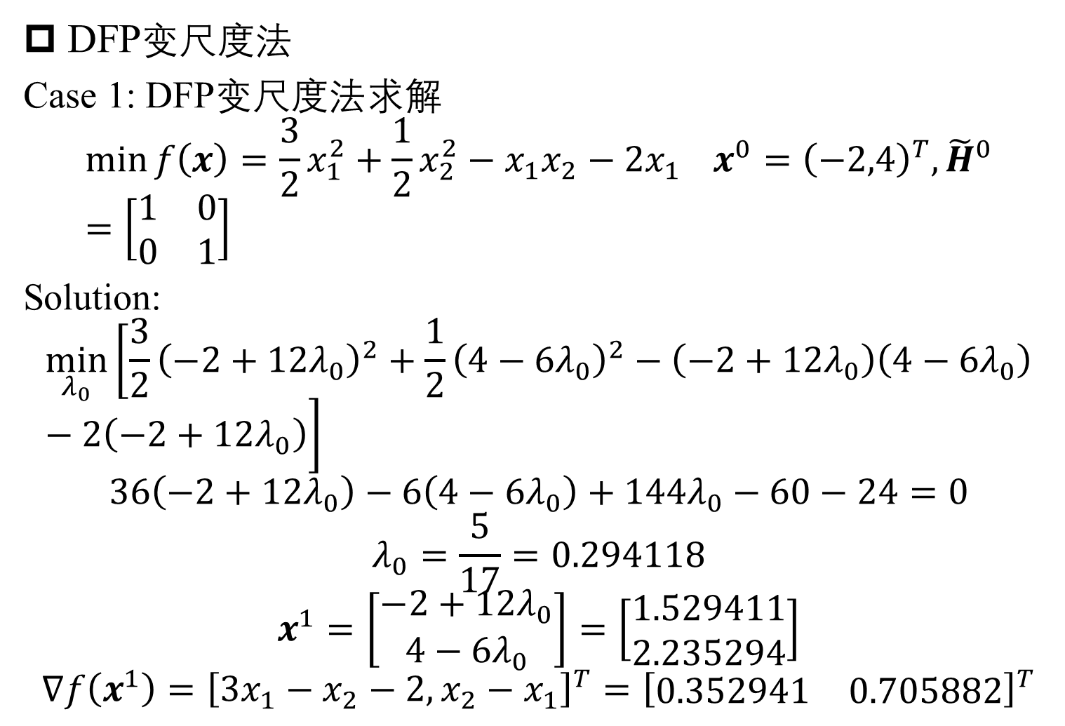
Optimization algorithm for multi-variables
DFP变尺度法
Case 1: DFP变尺度法求解
$$\min{f\left(x\right)=\frac{3}{2}x_{1}^{2}+\frac{1}{2}x_{2}^{2}−x_{1}x_{2}−2x_{1}} x^{0}={\left(−2,4\right)}^{T}, {\tilde{H}}^{0}=\left[\begin{matrix}1 & 0 \\ 0 & 1\end{matrix}\right]$$
Solution:
$$\min_{λ_{0}}\left[\frac{3}{2}{\left(−2+12λ_{0}\right)}^{2}+\frac{1}{2}{\left(4−6λ_{0}\right)}^{2}−\left(−2+12λ_{0}\right)\left(4−6λ_{0}\right)−2\left(−2+12λ_{0}\right)\right]$$
$$36\left(−2+12λ_{0}\right)−6\left(4−6λ_{0}\right)+144λ_{0}−60−24=0$$
$$λ_{0}=\frac{5}{17}=0.294118$$
$$x^{1}=\left[\begin{matrix}−2+12λ_{0} \\ 4−6λ_{0}\end{matrix}\right]=\left[\begin{matrix}1.529411 \\ 2.235294\end{matrix}\right]$$
$$∇f\left(x^{1}\right)={\left[3x_{1}−x_{2}−2, x_{2}−x_{1}\right]}^{T}={\left[\begin{matrix}0.352941 & 0.705882\end{matrix}\right]}^{T}$$

Slide 15
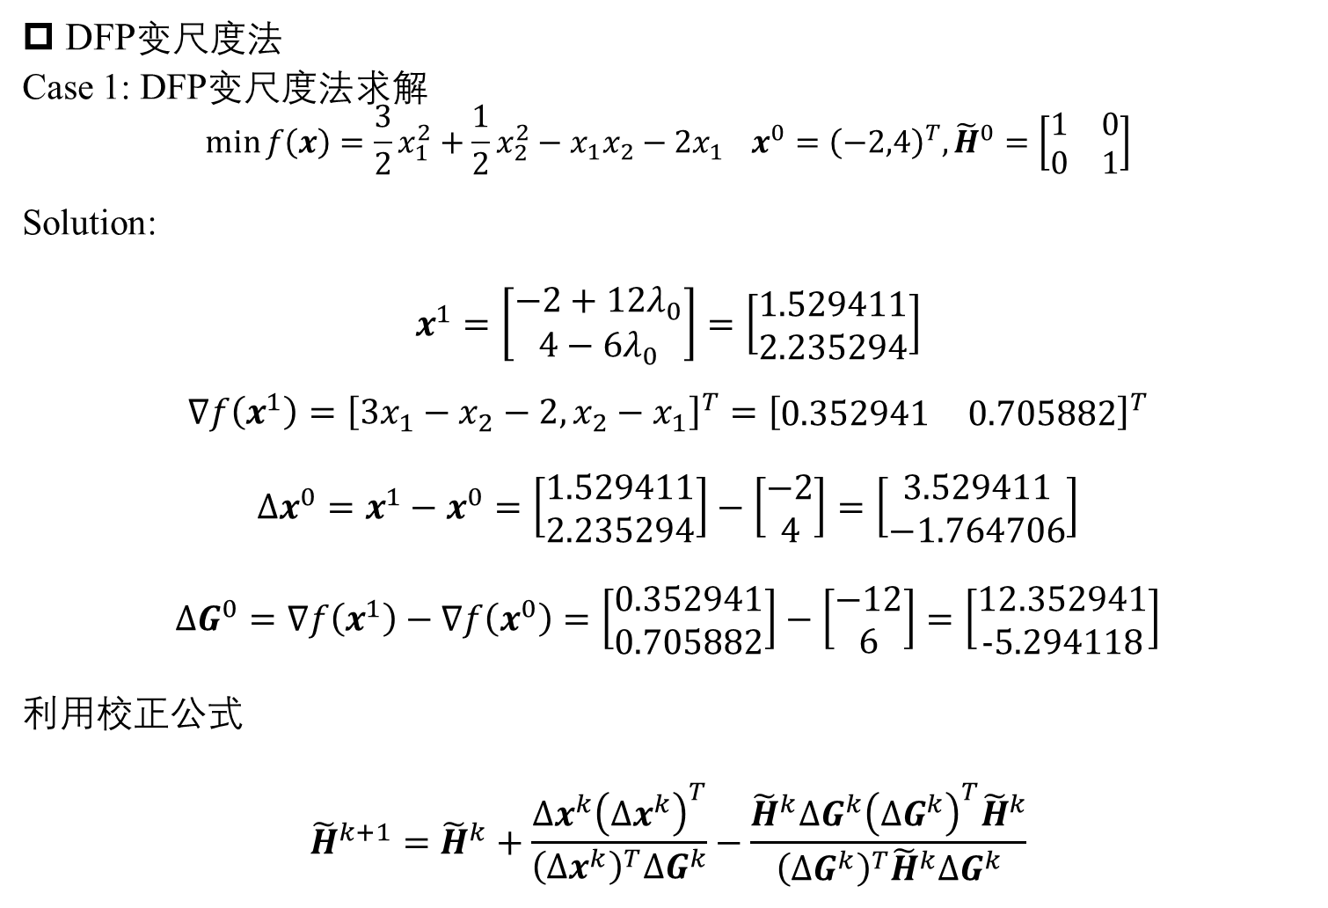
Optimization algorithm for multi-variables
DFP变尺度法
Case 1: DFP变尺度法求解
$$\min{f\left(x\right)=\frac{3}{2}x_{1}^{2}+\frac{1}{2}x_{2}^{2}−x_{1}x_{2}−2x_{1}} x^{0}={\left(−2,4\right)}^{T}, {\tilde{H}}^{0}=\left[\begin{matrix}1 & 0 \\ 0 & 1\end{matrix}\right]$$
Solution:
$$x^{1}=\left[\begin{matrix}−2+12λ_{0} \\ 4−6λ_{0}\end{matrix}\right]=\left[\begin{matrix}1.529411 \\ 2.235294\end{matrix}\right]$$
$$∇f\left(x^{1}\right)={\left[3x_{1}−x_{2}−2, x_{2}−x_{1}\right]}^{T}={\left[\begin{matrix}0.352941 & 0.705882\end{matrix}\right]}^{T}$$
$$Δx^{0}=x^{1}−x^{0}=\left[\begin{matrix}1.529411 \\ 2.235294\end{matrix}\right]−\left[\begin{matrix}−2 \\ 4\end{matrix}\right]=\left[\begin{matrix}3.529411 \\ −1.764706\end{matrix}\right]$$
$$ΔG^{0}=∇f\left(x^{1}\right)−∇f\left(x^{0}\right)=\left[\begin{matrix}0.352941 \\ 0.705882\end{matrix}\right]−\left[\begin{matrix}−12 \\ 6\end{matrix}\right]=\left[\begin{matrix}12.352941 \\ −5.294118\end{matrix}\right]$$
利用校正公式
$${\tilde{H}}^{k+1}={\tilde{H}}^{k}+\frac{Δx^{k}{\left(Δx^{k}\right)}^{T}}{{\left(Δx^{k}\right)}^{T}ΔG^{k}}−\frac{{\tilde{H}}^{k}ΔG^{k}{\left(ΔG^{k}\right)}^{T}{\tilde{H}}^{k}}{{\left(ΔG^{k}\right)}^{T}{\tilde{H}}^{k}ΔG^{k}}$$

Slide 16
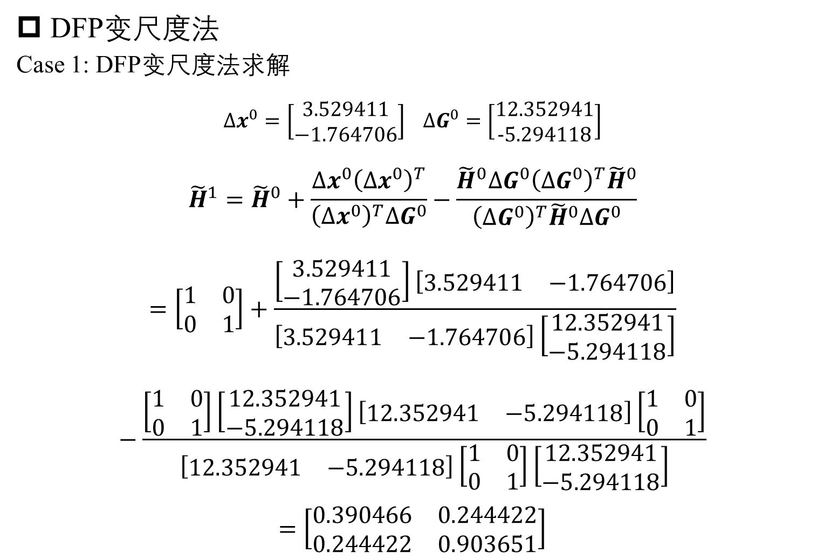
Optimization algorithm for multi-variables
DFP变尺度法
Case 1: DFP变尺度法求解
$$Δx^{0}=\left[\begin{matrix}3.529411 \\ −1.764706\end{matrix}\right] ΔG^{0}=\left[\begin{matrix}12.352941 \\ −5.294118\end{matrix}\right]$$
$${\tilde{H}}^{1}={\tilde{H}}^{0}+\frac{Δx^{0}{\left(Δx^{0}\right)}^{T}}{{\left(Δx^{0}\right)}^{T}ΔG^{0}}−\frac{{\tilde{H}}^{0}ΔG^{0}{\left(ΔG^{0}\right)}^{T}{\tilde{H}}^{0}}{{\left(ΔG^{0}\right)}^{T}{\tilde{H}}^{0}ΔG^{0}}=\left[\begin{matrix}1 & 0 \\ 0 & 1\end{matrix}\right]+\frac{\left[\begin{matrix}3.529411 \\ −1.764706\end{matrix}\right]\left[\begin{matrix}3.529411 & −1.764706\end{matrix}\right]}{\left[\begin{matrix}3.529411 & −1.764706\end{matrix}\right]\left[\begin{matrix}12.352941 \\ −5.294118\end{matrix}\right]}−\frac{\left[\begin{matrix}1 & 0 \\ 0 & 1\end{matrix}\right]\left[\begin{matrix}12.352941 \\ −5.294118\end{matrix}\right]\left[\begin{matrix}12.352941 & −5.294118\end{matrix}\right]\left[\begin{matrix}1 & 0 \\ 0 & 1\end{matrix}\right]}{\left[\begin{matrix}12.352941 & −5.294118\end{matrix}\right]\left[\begin{matrix}1 & 0 \\ 0 & 1\end{matrix}\right]\left[\begin{matrix}12.352941 \\ −5.294118\end{matrix}\right]}=\left[\begin{matrix}0.390466 & 0.244422 \\ 0.244422 & 0.903651\end{matrix}\right]$$

Slide 17
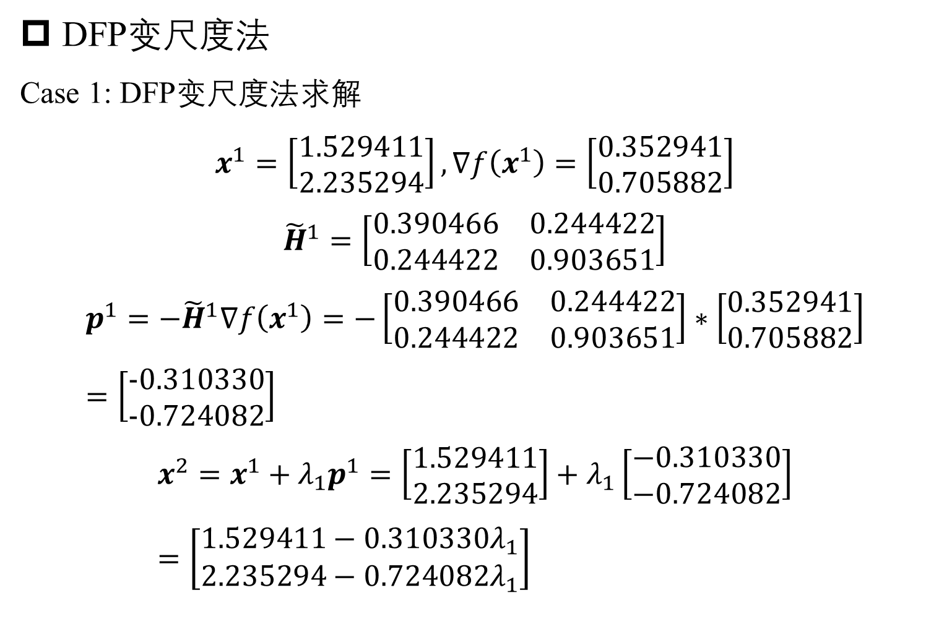
Optimization algorithm for multi-variables
DFP变尺度法
Case 1: DFP变尺度法求解
$$x^{1}=\left[\begin{matrix}1.529411 \\ 2.235294\end{matrix}\right],∇f\left(x^{1}\right)=\left[\begin{matrix}0.352941 \\ 0.705882\end{matrix}\right]$$
$${\tilde{H}}^{1}=\left[\begin{matrix}0.390466 & 0.244422 \\ 0.244422 & 0.903651\end{matrix}\right]$$
$$p^{1}=−{\tilde{H}}^{1}∇f\left(x^{1}\right)=−\left[\begin{matrix}0.390466 & 0.244422 \\ 0.244422 & 0.903651\end{matrix}\right]∗\left[\begin{matrix}0.352941 \\ 0.705882\end{matrix}\right]=\left[\begin{matrix}−0.310330 \\ −0.724082\end{matrix}\right]$$
$$x^{2}=x^{1}+λ_{1}p^{1}=\left[\begin{matrix}1.529411 \\ 2.235294\end{matrix}\right]+λ_{1}\left[\begin{matrix}−0.310330 \\ −0.724082\end{matrix}\right]=\left[\begin{matrix}1.529411−0.310330λ_{1} \\ 2.235294−0.724082λ_{1}\end{matrix}\right]$$

Slide 18
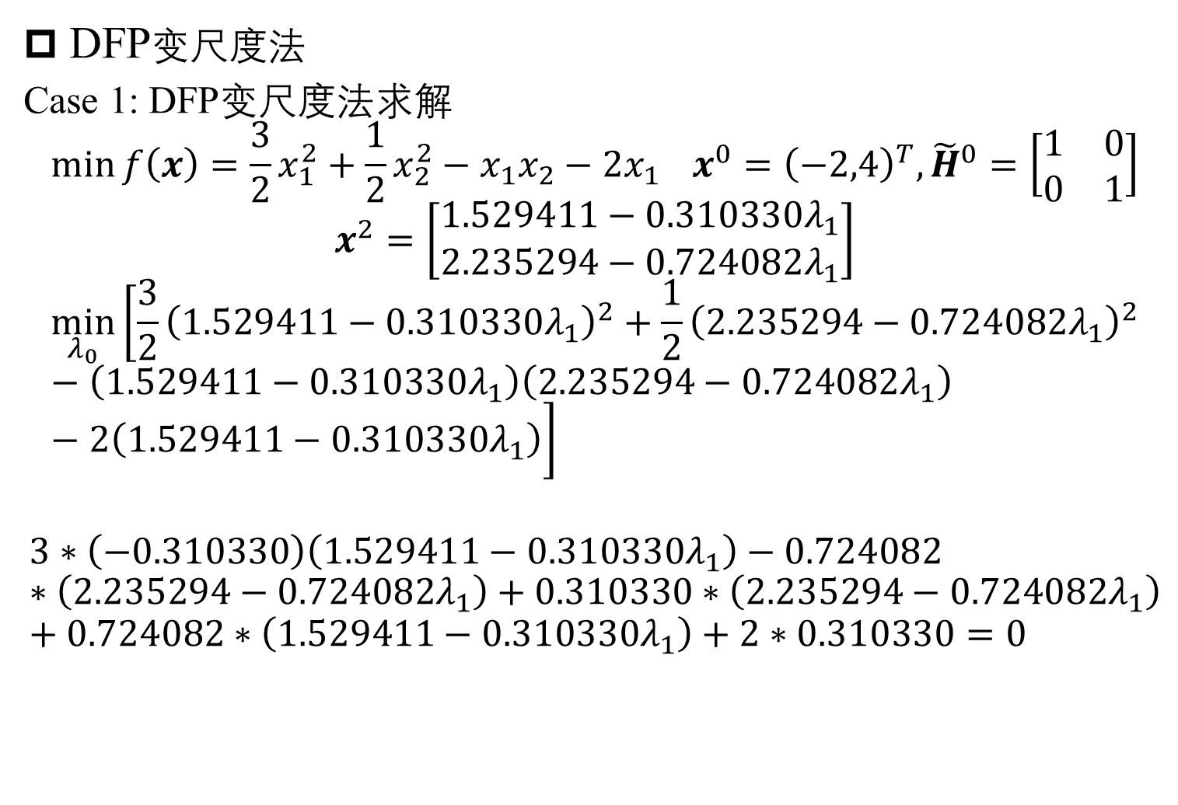
Optimization algorithm for multi-variables
DFP变尺度法
Case 1: DFP变尺度法求解
$$\min{f\left(x\right)=\frac{3}{2}x_{1}^{2}+\frac{1}{2}x_{2}^{2}−x_{1}x_{2}−2x_{1}} x^{0}={\left(−2,4\right)}^{T}, {\tilde{H}}^{0}=\left[\begin{matrix}1 & 0 \\ 0 & 1\end{matrix}\right]$$
$$x^{2}=\left[\begin{matrix}1.529411−0.310330λ_{1} \\ 2.235294−0.724082λ_{1}\end{matrix}\right]$$
$$\min_{λ_{0}}\left[\frac{3}{2}{\left(1.529411−0.310330λ_{1}\right)}^{2}+\frac{1}{2}{\left(2.235294−0.724082λ_{1}\right)}^{2}−\left(1.529411−0.310330λ_{1}\right)\left(2.235294−0.724082λ_{1}\right)−2\left(1.529411−0.310330λ_{1}\right)\right]$$
$$3∗\left(−0.310330\right)\left(1.529411−0.310330λ_{1}\right)−0.724082∗\left(2.235294−0.724082λ_{1}\right)+0.310330∗\left(2.235294−0.724082λ_{1}\right)+0.724082∗\left(1.529411−0.310330λ_{1}\right)+2∗0.310330=0$$

Slide 19
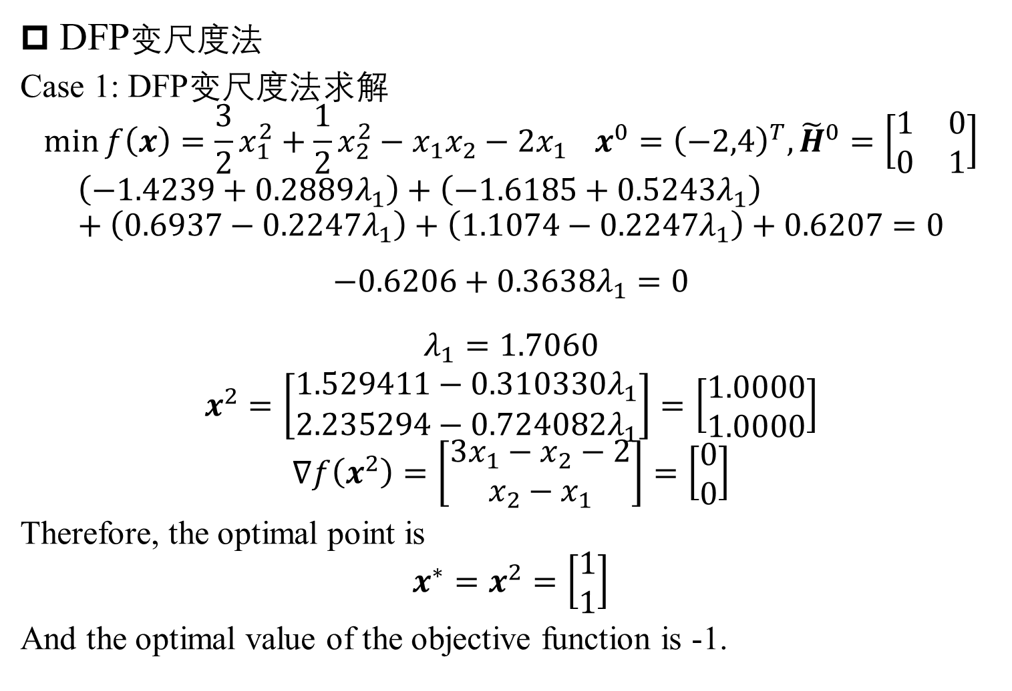
Optimization algorithm for multi-variables
DFP变尺度法
Case 1: DFP变尺度法求解
$$\min{f\left(x\right)=\frac{3}{2}x_{1}^{2}+\frac{1}{2}x_{2}^{2}−x_{1}x_{2}−2x_{1}} x^{0}={\left(−2,4\right)}^{T}, {\tilde{H}}^{0}=\left[\begin{matrix}1 & 0 \\ 0 & 1\end{matrix}\right]$$
$$\left(−1.4239+0.2889λ_{1}\right)+\left(−1.6185+0.5243λ_{1}\right)+\left(0.6937−0.2247λ_{1}\right)+\left(1.1074−0.2247λ_{1}\right)+0.6207=0$$
$$−0.6206+0.3638λ_{1}=0$$
$$λ_{1}=1.7060$$
$$x^{2}=\left[\begin{matrix}1.529411−0.310330λ_{1} \\ 2.235294−0.724082λ_{1}\end{matrix}\right]=\left[\begin{matrix}1.0000 \\ 1.0000\end{matrix}\right]$$
$$∇f\left(x^{2}\right)=\left[\begin{matrix}3x_{1}−x_{2}−2 \\ x_{2}−x_{1}\end{matrix}\right]=\left[\begin{matrix}0 \\ 0\end{matrix}\right]$$
Therefore, the optimal point is
$$x^{∗}=x^{2}=\left[\begin{matrix}1 \\ 1\end{matrix}\right]$$
And the optimal value of the objective function is -1.

Slide 20
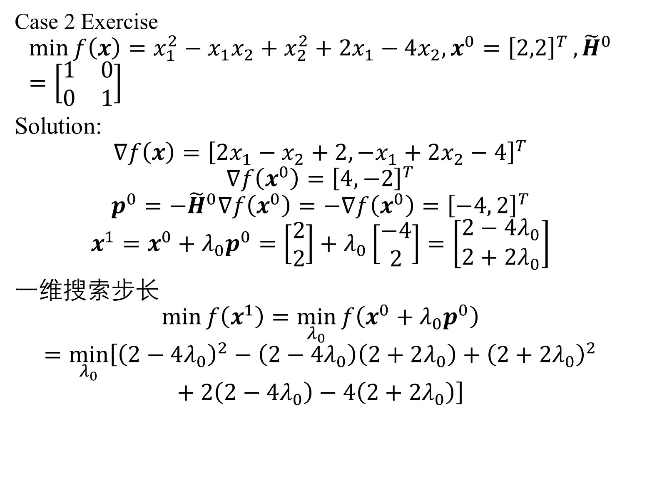
Optimization algorithm for multi-variables
Case 2 Exercise
$$\min{f\left(x\right)=x_{1}^{2}−x_{1}x_{2}+x_{2}^{2}+2x_{1}−4x_{2}, x^{0}={\left[2,2\right]}^{T}},{\tilde{H}}^{0}=\left[\begin{matrix}1 & 0 \\ 0 & 1\end{matrix}\right]$$
Solution:
$$∇f\left(x\right)={\left[2x_{1}−x_{2}+2, −x_{1}+2x_{2}−4\right]}^{T}$$
$$∇f\left(x^{0}\right)={\left[4, −2\right]}^{T}$$
$$p^{0}=−{\tilde{H}}^{0}∇f\left(x^{0}\right)=−∇f\left(x^{0}\right)={\left[−4, 2\right]}^{T}$$
$$x^{1}=x^{0}+λ_{0}p^{0}=\left[\begin{matrix}2 \\ 2\end{matrix}\right]+λ_{0}\left[\begin{matrix}−4 \\ 2\end{matrix}\right]=\left[\begin{matrix}2−4λ_{0} \\ 2+2λ_{0}\end{matrix}\right]$$
一维搜索步长
$$\min{f\left(x^{1}\right)}=\min_{λ_{0}}{f\left(x^{0}+λ_{0}p^{0}\right)}=\min_{λ_{0}}\left[{\left(2−4λ_{0}\right)}^{2}−\left(2−4λ_{0}\right)\left(2+2λ_{0}\right)+{\left(2+2λ_{0}\right)}^{2}+2\left(2−4λ_{0}\right)−4\left(2+2λ_{0}\right)\right]$$

Slide 21
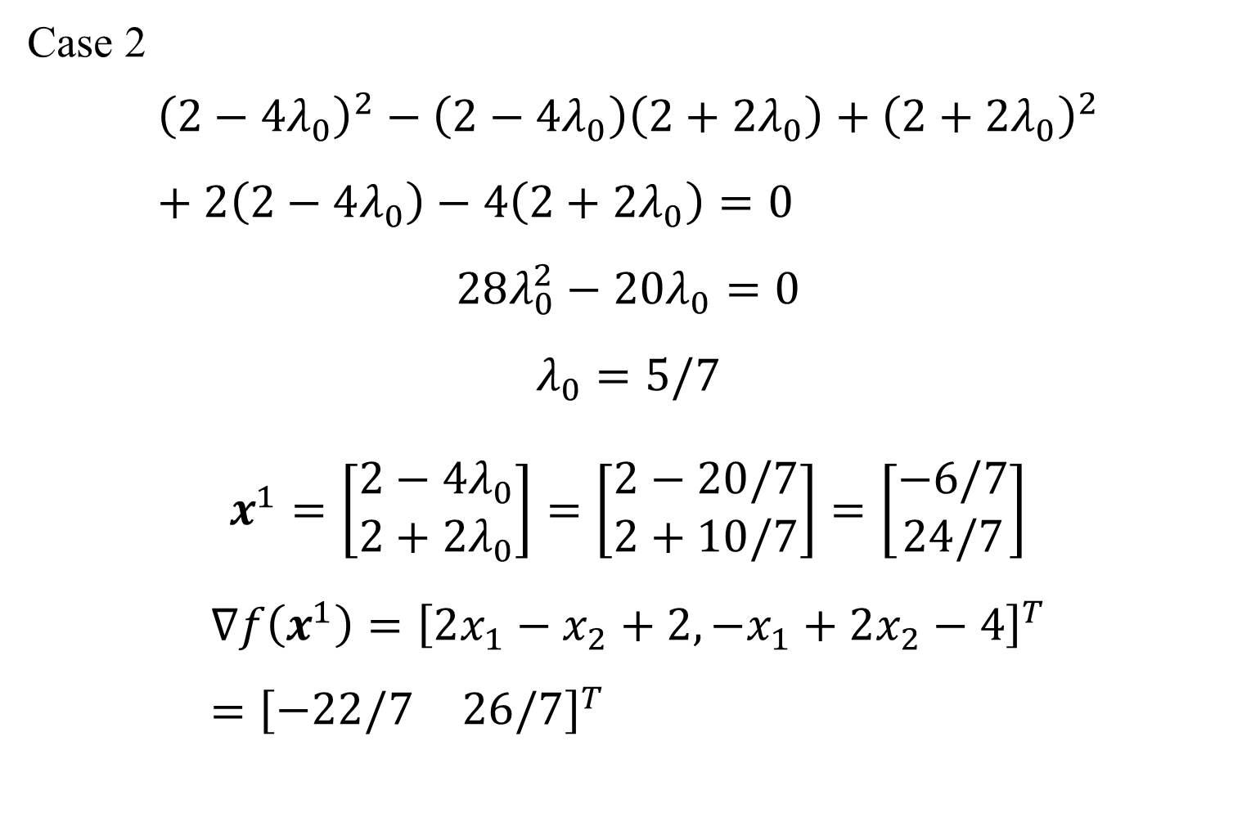
Optimization algorithm for multi-variables
Case 2
$${\left(2−4λ_{0}\right)}^{2}−\left(2−4λ_{0}\right)\left(2+2λ_{0}\right)+{\left(2+2λ_{0}\right)}^{2}+2\left(2−4λ_{0}\right)−4\left(2+2λ_{0}\right)=0$$
$$28λ_{0}^{2}−20λ_{0}=0$$
$$λ_{0}=5/7$$
$$x^{1}=\left[\begin{matrix}2−4λ_{0} \\ 2+2λ_{0}\end{matrix}\right]=\left[\begin{matrix}2−20/7 \\ 2+10/7\end{matrix}\right]=\left[\begin{matrix}−6/7 \\ 24/7\end{matrix}\right]$$
$$∇f\left(x^{1}\right)={\left[2x_{1}−x_{2}+2, −x_{1}+2x_{2}−4\right]}^{T}={\left[\begin{matrix}−22/7 & 26/7\end{matrix}\right]}^{T}$$

Slide 22
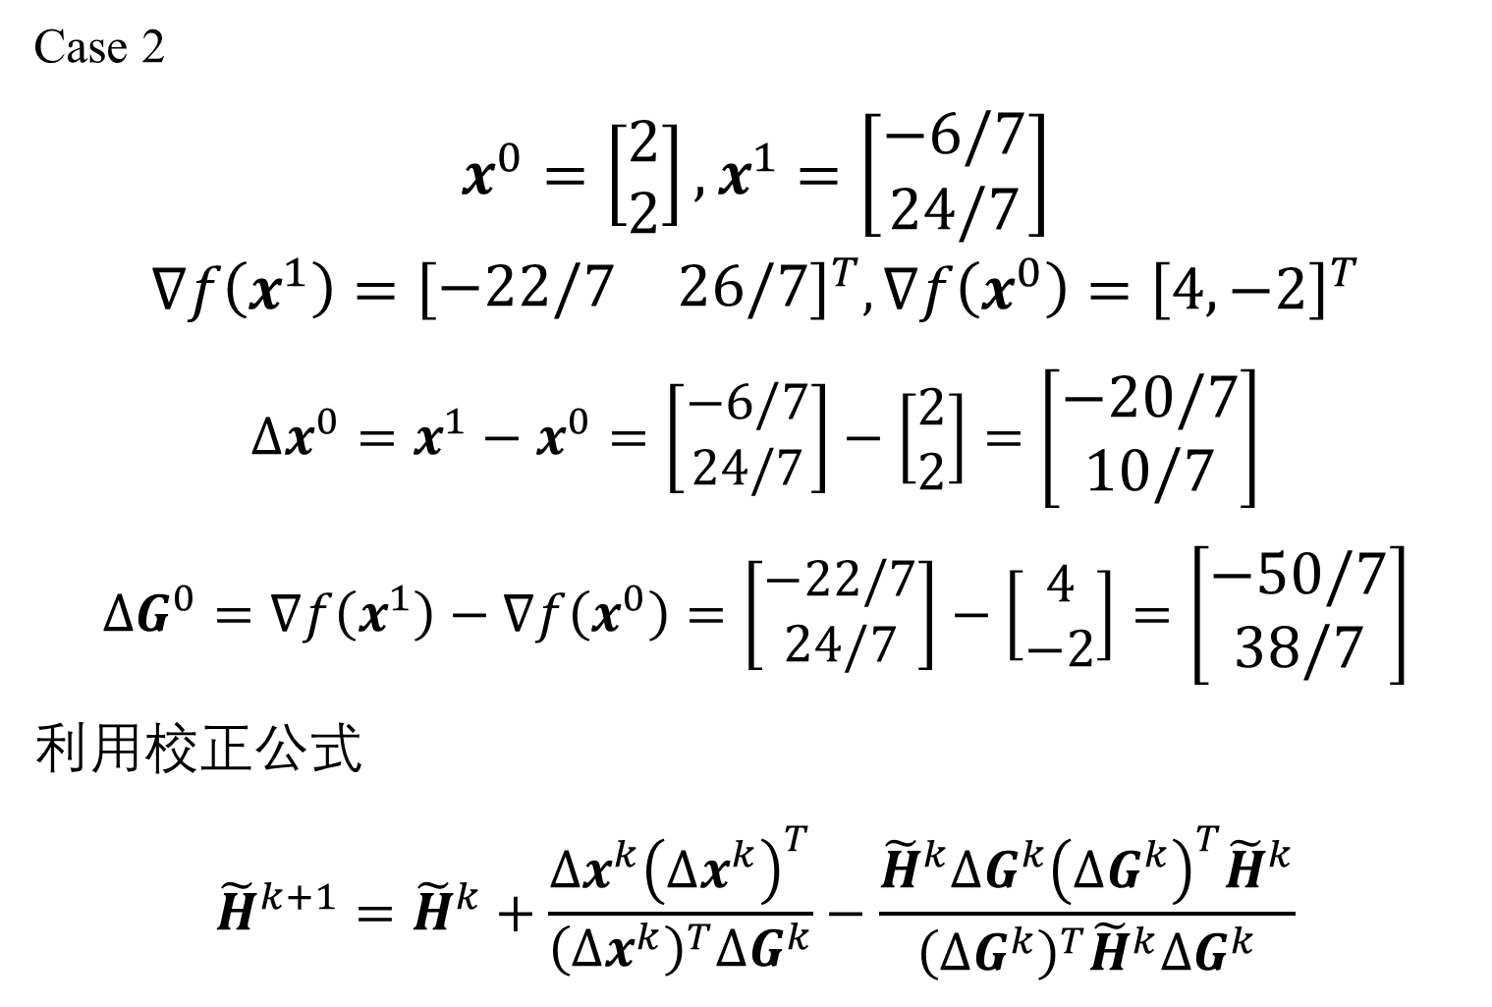
Optimization algorithm for multi-variables
Case 2
$$x^{0}=\left[\begin{matrix}2 \\ 2\end{matrix}\right],x^{1}=\left[\begin{matrix}−6/7 \\ 24/7\end{matrix}\right]$$
$$∇f\left(x^{1}\right)={\left[\begin{matrix}−22/7 & 26/7\end{matrix}\right]}^{T},∇f\left(x^{0}\right)={\left[4, −2\right]}^{T}$$
$$Δx^{0}=x^{1}−x^{0}=\left[\begin{matrix}−6/7 \\ 24/7\end{matrix}\right]−\left[\begin{matrix}2 \\ 2\end{matrix}\right]=\left[\begin{matrix}−20/7 \\ 10/7\end{matrix}\right]$$
$$ΔG^{0}=∇f\left(x^{1}\right)−∇f\left(x^{0}\right)=\left[\begin{matrix}−22/7 \\ 24/7\end{matrix}\right]−\left[\begin{matrix}4 \\ −2\end{matrix}\right]=\left[\begin{matrix}−50/7 \\ 38/7\end{matrix}\right]$$
利用校正公式
$${\tilde{H}}^{k+1}={\tilde{H}}^{k}+\frac{Δx^{k}{\left(Δx^{k}\right)}^{T}}{{\left(Δx^{k}\right)}^{T}ΔG^{k}}−\frac{{\tilde{H}}^{k}ΔG^{k}{\left(ΔG^{k}\right)}^{T}{\tilde{H}}^{k}}{{\left(ΔG^{k}\right)}^{T}{\tilde{H}}^{k}ΔG^{k}}$$

Slide 23
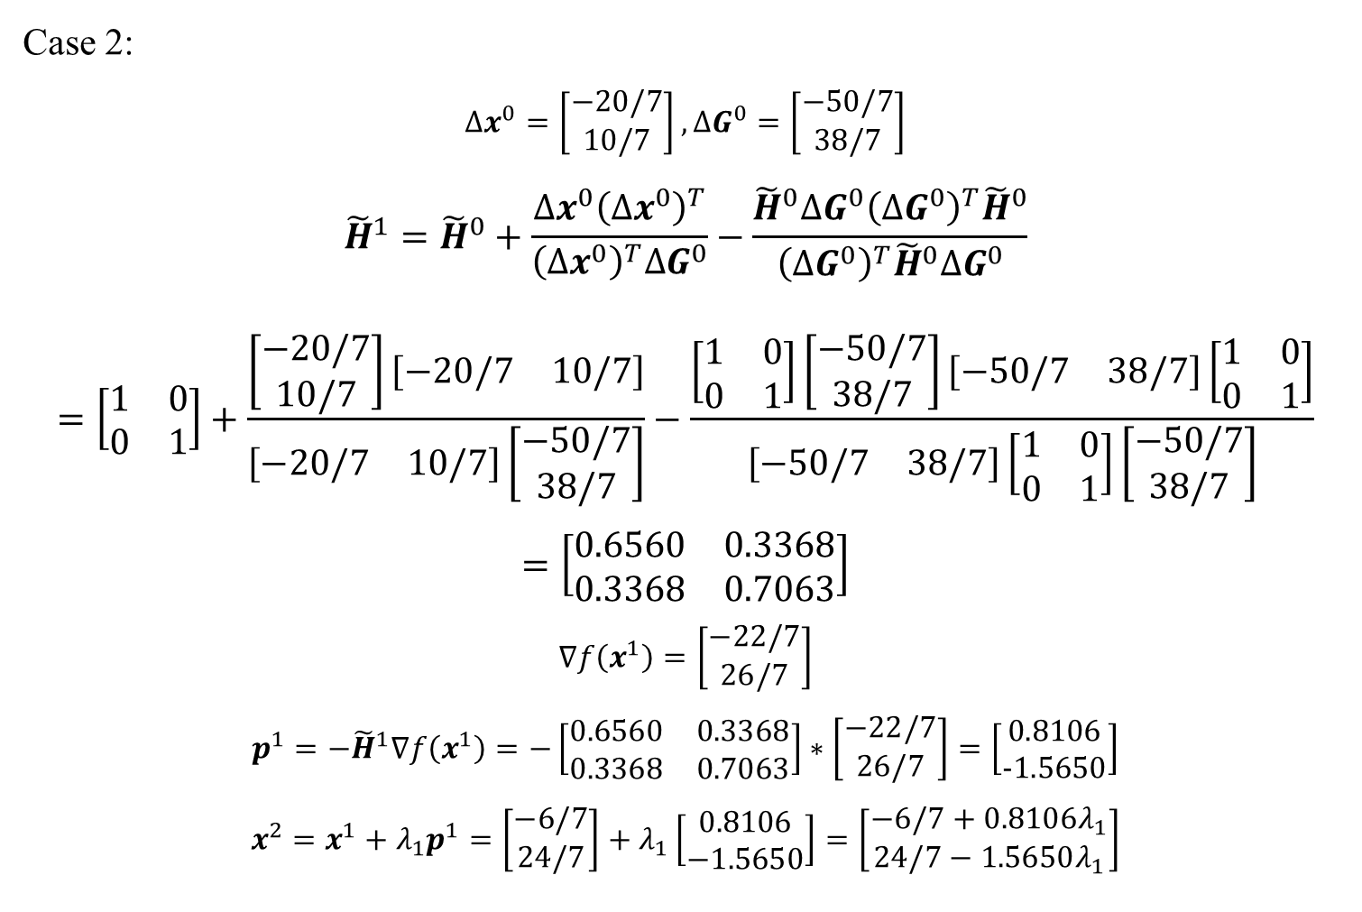
Optimization algorithm for multi-variables
Case 2:
$$Δx^{0}=\left[\begin{matrix}−20/7 \\ 10/7\end{matrix}\right],ΔG^{0}=\left[\begin{matrix}−50/7 \\ 38/7\end{matrix}\right]$$
$${\tilde{H}}^{1}={\tilde{H}}^{0}+\frac{Δx^{0}{\left(Δx^{0}\right)}^{T}}{{\left(Δx^{0}\right)}^{T}ΔG^{0}}−\frac{{\tilde{H}}^{0}ΔG^{0}{\left(ΔG^{0}\right)}^{T}{\tilde{H}}^{0}}{{\left(ΔG^{0}\right)}^{T}{\tilde{H}}^{0}ΔG^{0}}=\left[\begin{matrix}1 & 0 \\ 0 & 1\end{matrix}\right]+\frac{\left[\begin{matrix}−20/7 \\ 10/7\end{matrix}\right]\left[\begin{matrix}−20/7 & 10/7\end{matrix}\right]}{\left[\begin{matrix}−20/7 & 10/7\end{matrix}\right]\left[\begin{matrix}−50/7 \\ 38/7\end{matrix}\right]}−\frac{\left[\begin{matrix}1 & 0 \\ 0 & 1\end{matrix}\right]\left[\begin{matrix}−50/7 \\ 38/7\end{matrix}\right]\left[\begin{matrix}−50/7 & 38/7\end{matrix}\right]\left[\begin{matrix}1 & 0 \\ 0 & 1\end{matrix}\right]}{\left[\begin{matrix}−50/7 & 38/7\end{matrix}\right]\left[\begin{matrix}1 & 0 \\ 0 & 1\end{matrix}\right]\left[\begin{matrix}−50/7 \\ 38/7\end{matrix}\right]}=\left[\begin{matrix}0.6560 & 0.3368 \\ 0.3368 & 0.7063\end{matrix}\right]$$
$$∇f\left(x^{1}\right)=\left[\begin{matrix}−22/7 \\ 26/7\end{matrix}\right]$$
$$p^{1}=−{\tilde{H}}^{1}∇f\left(x^{1}\right)=−\left[\begin{matrix}0.6560 & 0.3368 \\ 0.3368 & 0.7063\end{matrix}\right]∗\left[\begin{matrix}−22/7 \\ 26/7\end{matrix}\right]=\left[\begin{matrix}0.8106 \\ −1.5650\end{matrix}\right]$$
$$x^{2}=x^{1}+λ_{1}p^{1}=\left[\begin{matrix}−6/7 \\ 24/7\end{matrix}\right]+λ_{1}\left[\begin{matrix}0.8106 \\ −1.5650\end{matrix}\right]=\left[\begin{matrix}−6/7+0.8106λ_{1} \\ 24/7−1.5650λ_{1}\end{matrix}\right]$$

Slide 24
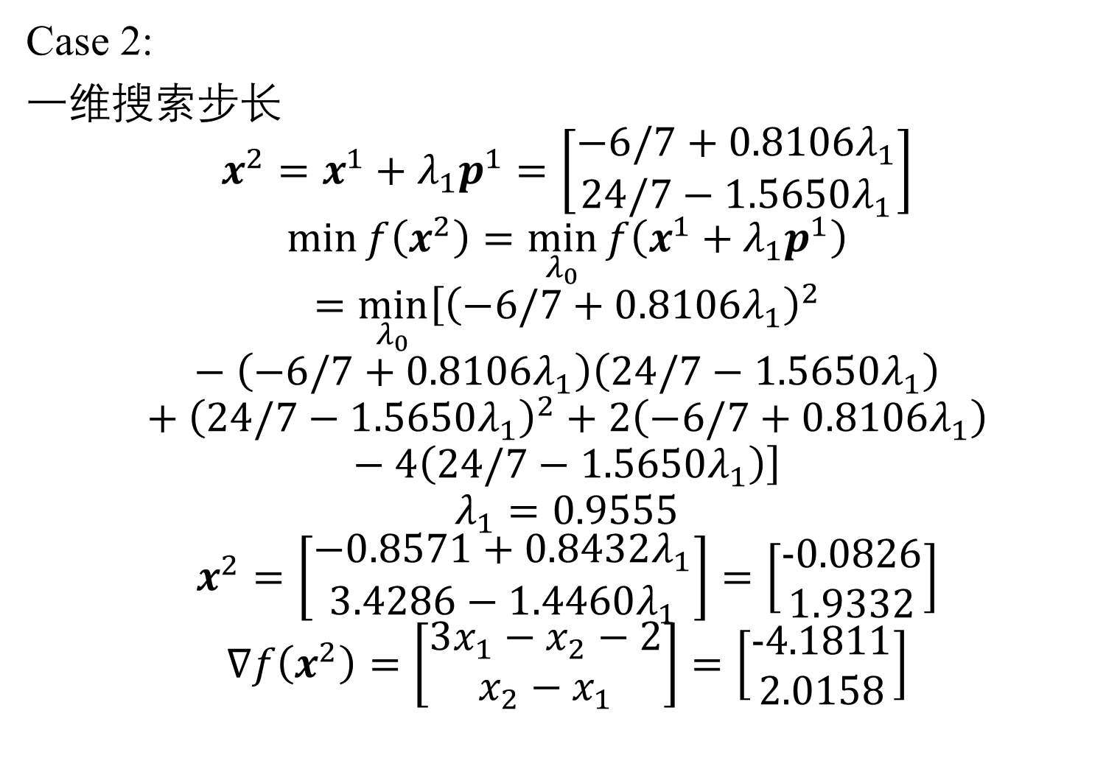
Optimization algorithm for multi-variables
Case 2:
一维搜索步长
$$x^{2}=x^{1}+λ_{1}p^{1}=\left[\begin{matrix}−6/7+0.8106λ_{1} \\ 24/7−1.5650λ_{1}\end{matrix}\right]$$
$$\min{f\left(x^{2}\right)}=\min_{λ_{0}}{f\left(x^{1}+λ_{1}p^{1}\right)}=\min_{λ_{0}}\left[{\left(−6/7+0.8106λ_{1}\right)}^{2}−\left(−6/7+0.8106λ_{1}\right)\left(24/7−1.5650λ_{1}\right)+{\left(24/7−1.5650λ_{1}\right)}^{2}+2\left(−6/7+0.8106λ_{1}\right)−4\left(24/7−1.5650λ_{1}\right)\right]$$
$$λ_{1}=0.9555$$
$$x^{2}=\left[\begin{matrix}−0.8571+0.8432λ_{1} \\ 3.4286−1.4460λ_{1}\end{matrix}\right]=\left[\begin{matrix}−0.0826 \\ 1.9332\end{matrix}\right]$$
$$∇f\left(x^{2}\right)=\left[\begin{matrix}3x_{1}−x_{2}−2 \\ x_{2}−x_{1}\end{matrix}\right]=\left[\begin{matrix}−4.1811 \\ 2.0158\end{matrix}\right]$$

Slide 25
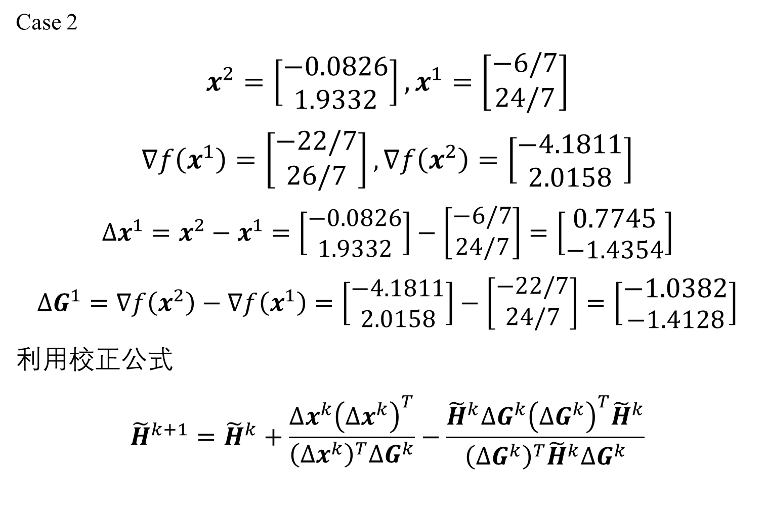
Optimization algorithm for multi-variables
Case 2
$$x^{2}=\left[\begin{matrix}−0.0826 \\ 1.9332\end{matrix}\right],x^{1}=\left[\begin{matrix}−6/7 \\ 24/7\end{matrix}\right]$$
$$∇f\left(x^{1}\right)=\left[\begin{matrix}−22/7 \\ 26/7\end{matrix}\right],∇f\left(x^{2}\right)=\left[\begin{matrix}−4.1811 \\ 2.0158\end{matrix}\right]$$
$$Δx^{1}=x^{2}−x^{1}=\left[\begin{matrix}−0.0826 \\ 1.9332\end{matrix}\right]−\left[\begin{matrix}−6/7 \\ 24/7\end{matrix}\right]=\left[\begin{matrix}0.7745 \\ −1.4354\end{matrix}\right]$$
$$ΔG^{1}=∇f\left(x^{2}\right)−∇f\left(x^{1}\right)=\left[\begin{matrix}−4.1811 \\ 2.0158\end{matrix}\right]−\left[\begin{matrix}−22/7 \\ 24/7\end{matrix}\right]=\left[\begin{matrix}−1.0382 \\ −1.4128\end{matrix}\right]$$
利用校正公式
$${\tilde{H}}^{k+1}={\tilde{H}}^{k}+\frac{Δx^{k}{\left(Δx^{k}\right)}^{T}}{{\left(Δx^{k}\right)}^{T}ΔG^{k}}−\frac{{\tilde{H}}^{k}ΔG^{k}{\left(ΔG^{k}\right)}^{T}{\tilde{H}}^{k}}{{\left(ΔG^{k}\right)}^{T}{\tilde{H}}^{k}ΔG^{k}}$$

Slide 26
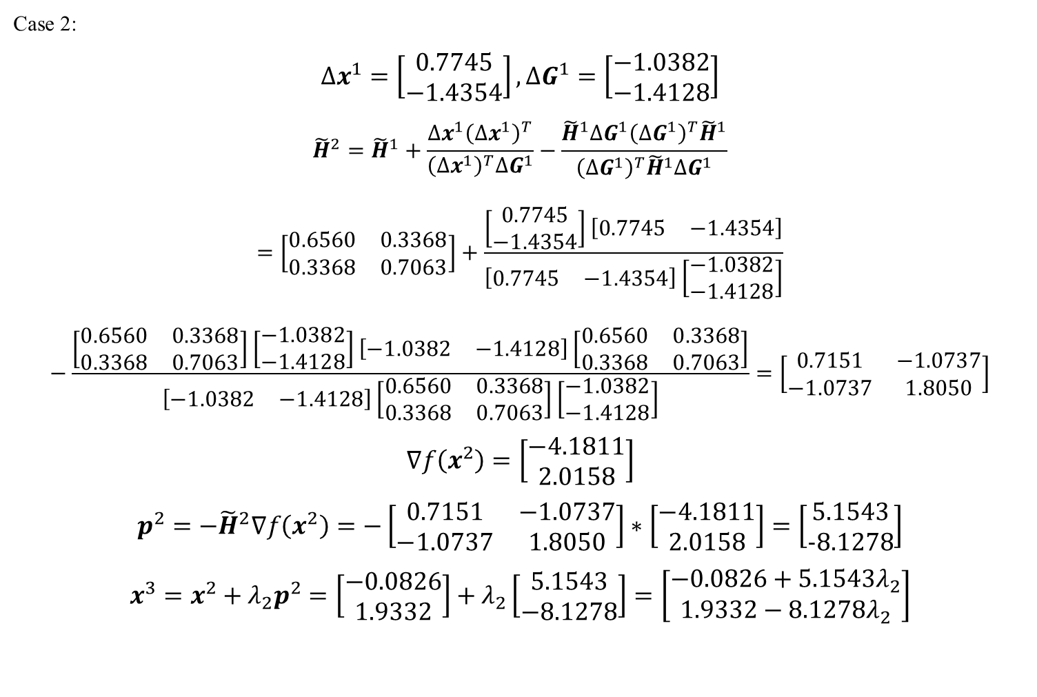
Optimization algorithm for multi-variables
Case 2:
$$Δx^{1}=\left[\begin{matrix}0.7745 \\ −1.4354\end{matrix}\right],ΔG^{1}=\left[\begin{matrix}−1.0382 \\ −1.4128\end{matrix}\right]$$
$${\tilde{H}}^{2}={\tilde{H}}^{1}+\frac{Δx^{1}{\left(Δx^{1}\right)}^{T}}{{\left(Δx^{1}\right)}^{T}ΔG^{1}}−\frac{{\tilde{H}}^{1}ΔG^{1}{\left(ΔG^{1}\right)}^{T}{\tilde{H}}^{1}}{{\left(ΔG^{1}\right)}^{T}{\tilde{H}}^{1}ΔG^{1}}=\left[\begin{matrix}0.6560 & 0.3368 \\ 0.3368 & 0.7063\end{matrix}\right]+\frac{\left[\begin{matrix}0.7745 \\ −1.4354\end{matrix}\right]\left[\begin{matrix}0.7745 & −1.4354\end{matrix}\right]}{\left[\begin{matrix}0.7745 & −1.4354\end{matrix}\right]\left[\begin{matrix}−1.0382 \\ −1.4128\end{matrix}\right]}−\frac{\left[\begin{matrix}0.6560 & 0.3368 \\ 0.3368 & 0.7063\end{matrix}\right]\left[\begin{matrix}−1.0382 \\ −1.4128\end{matrix}\right]\left[\begin{matrix}−1.0382 & −1.4128\end{matrix}\right]\left[\begin{matrix}0.6560 & 0.3368 \\ 0.3368 & 0.7063\end{matrix}\right]}{\left[\begin{matrix}−1.0382 & −1.4128\end{matrix}\right]\left[\begin{matrix}0.6560 & 0.3368 \\ 0.3368 & 0.7063\end{matrix}\right]\left[\begin{matrix}−1.0382 \\ −1.4128\end{matrix}\right]}=\left[\begin{matrix}0.7151 & −1.0737 \\ −1.0737 & 1.8050\end{matrix}\right]$$
$$∇f\left(x^{2}\right)=\left[\begin{matrix}−4.1811 \\ 2.0158\end{matrix}\right]$$
$$p^{2}=−{\tilde{H}}^{2}∇f\left(x^{2}\right)=−\left[\begin{matrix}0.7151 & −1.0737 \\ −1.0737 & 1.8050\end{matrix}\right]∗\left[\begin{matrix}−4.1811 \\ 2.0158\end{matrix}\right]=\left[\begin{matrix}5.1543 \\ −8.1278\end{matrix}\right]$$
$$x^{3}=x^{2}+λ_{2}p^{2}=\left[\begin{matrix}−0.0826 \\ 1.9332\end{matrix}\right]+λ_{2}\left[\begin{matrix}5.1543 \\ −8.1278\end{matrix}\right]=\left[\begin{matrix}−0.0826+5.1543λ_{2} \\ 1.9332−8.1278λ_{2}\end{matrix}\right]$$

